Slide 1
P&C (Re)Insurer’s Share Buyback ROI
2014 – 2018

Slide 2
P&C (Re)Insurer’s Share Buyback ROI
Goal
The goal of this analysis is to calculate the historical return on investment (ROI) of share buybacks for P&C (re)insurance companies over the past 20 quarters (2014 - 2018). This is one way to measure whether companies have effectively allocated their capital to share buybacks. We split the buyback ROI into two components – overall buyback ROI and buyback effectiveness - to understand how well a company has timed their share repurchases.
The methodology used is inherently backwards looking and answers the question:
Based on what we know now (i.e. a company's stock price over the period), did the company achieve a reasonable return on their cash spent buying back shares?
Methodology
The buyback ROI is calculated based on three items:
The cash outflows associated with share repurchases each quarter
The implied cash inflows of dividends (common and special) "avoided" by repurchasing shares
A final cash inflow related to the total value of the cumulative shares repurchased
Given this set of cash flows, we then calculate the annualized internal rate of return to give us the buyback ROI.
An additional metric to calculate is the "buyback effectiveness" return. This metric isolates the impact of management timing in repurchasing shares by backing out the total shareholder return over the time period from the buyback ROI. Buyback effectiveness equals one plus buyback ROI divided one plus total shareholder return (minus one). This metric highlights companies that successfully buyback more shares right before their stock price increases and buy less before their stock decreases.

Slide 3
P&C (Re)Insurer’s Share Buyback ROI
Data used
The data used for this analysis is from SEC Forms 10-Q and 10-K for each company over the time period of 2014 - 2018 on a quarterly basis, per S&P Global Market Intelligence.
Number of shares repurchased in the quarter
Average price per share for shares repurchased
Common shares outstanding
Common dividend per share
Special dividend per share
Book value per share
Additionally, historical share price data was downloaded from Yahoo Finance.

Slide 4
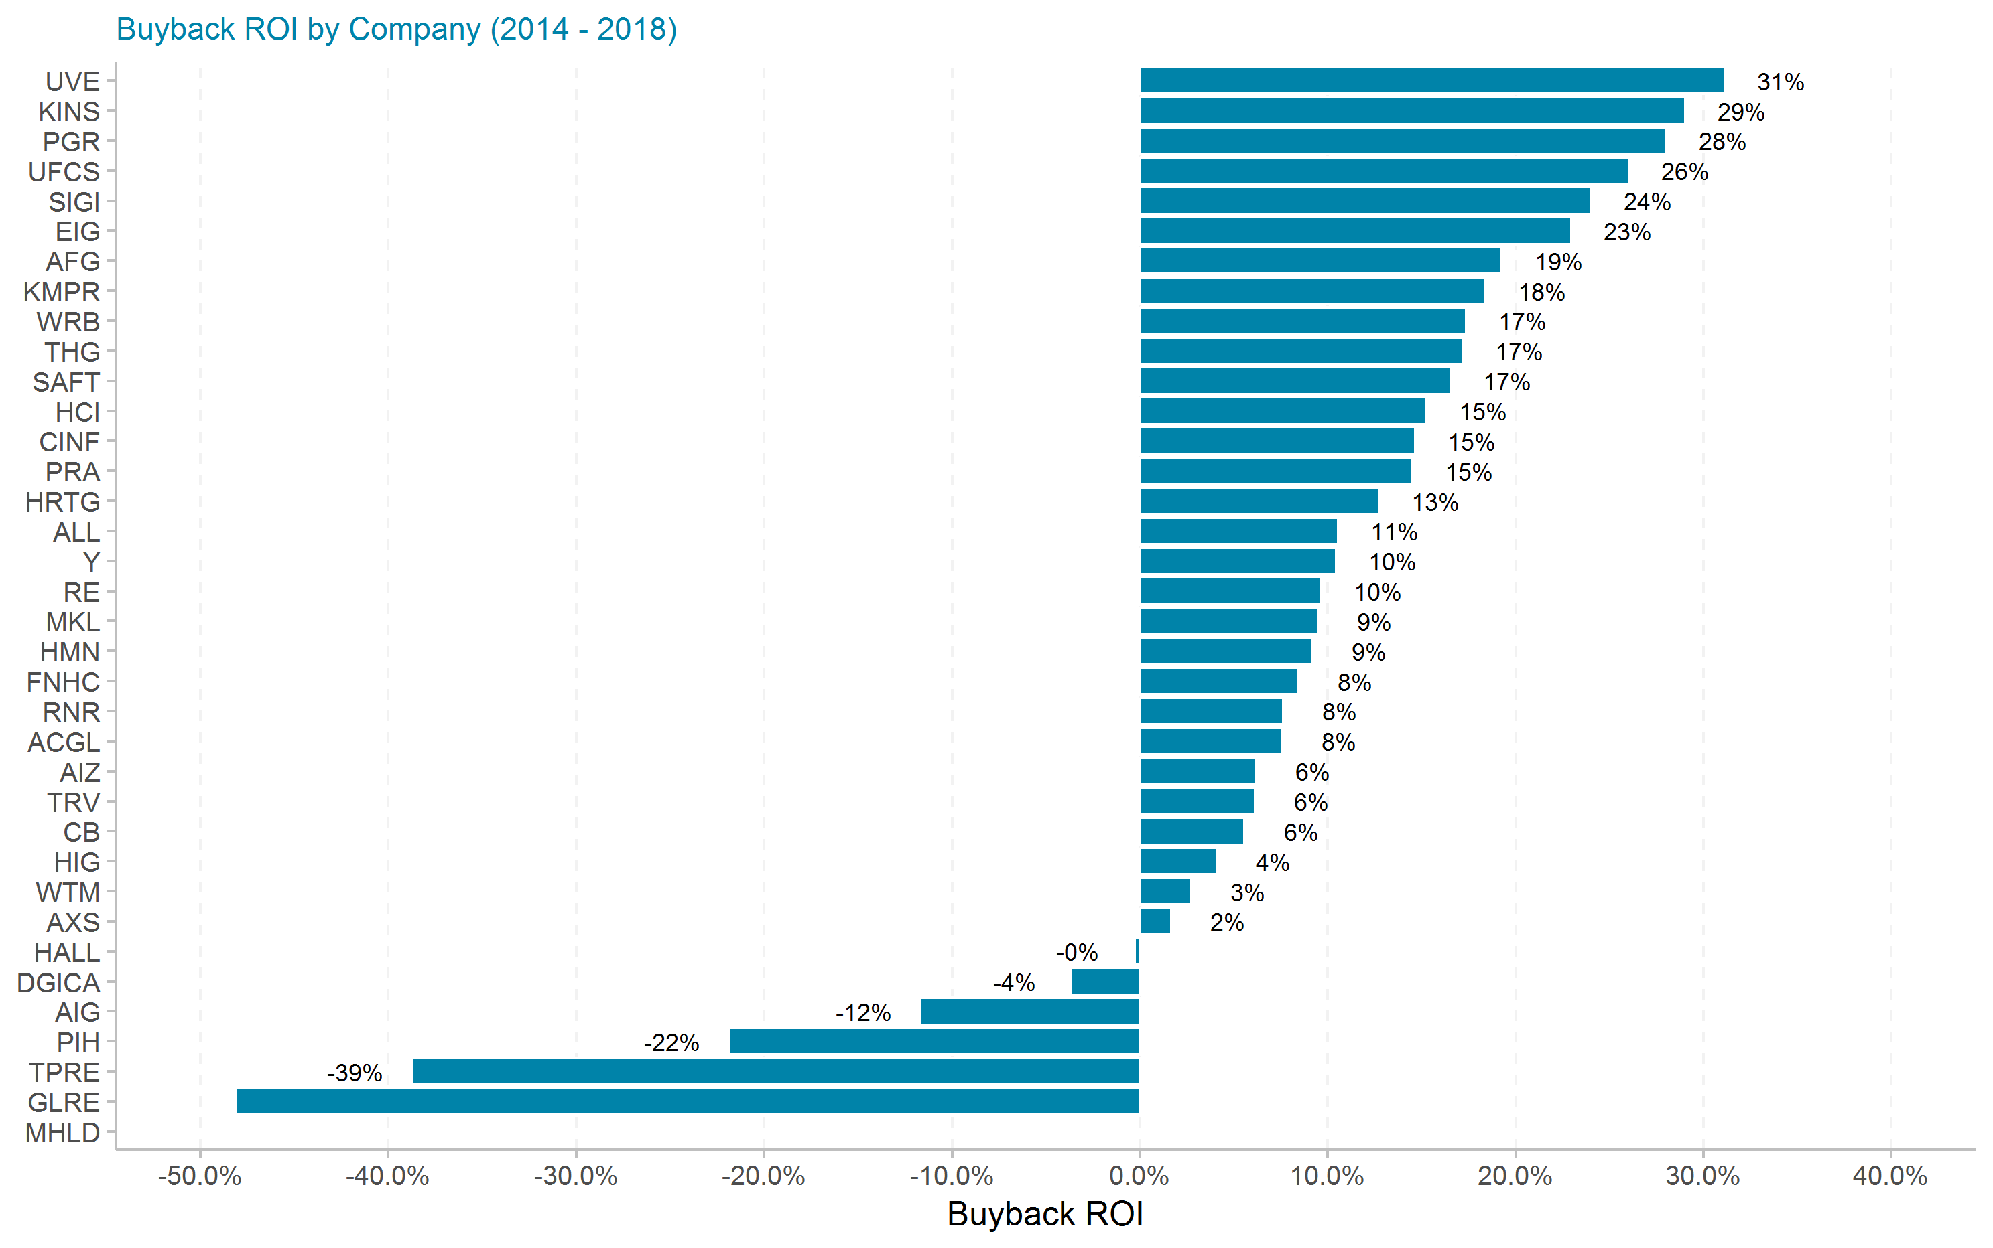
Buyback ROI by Company

Slide 5
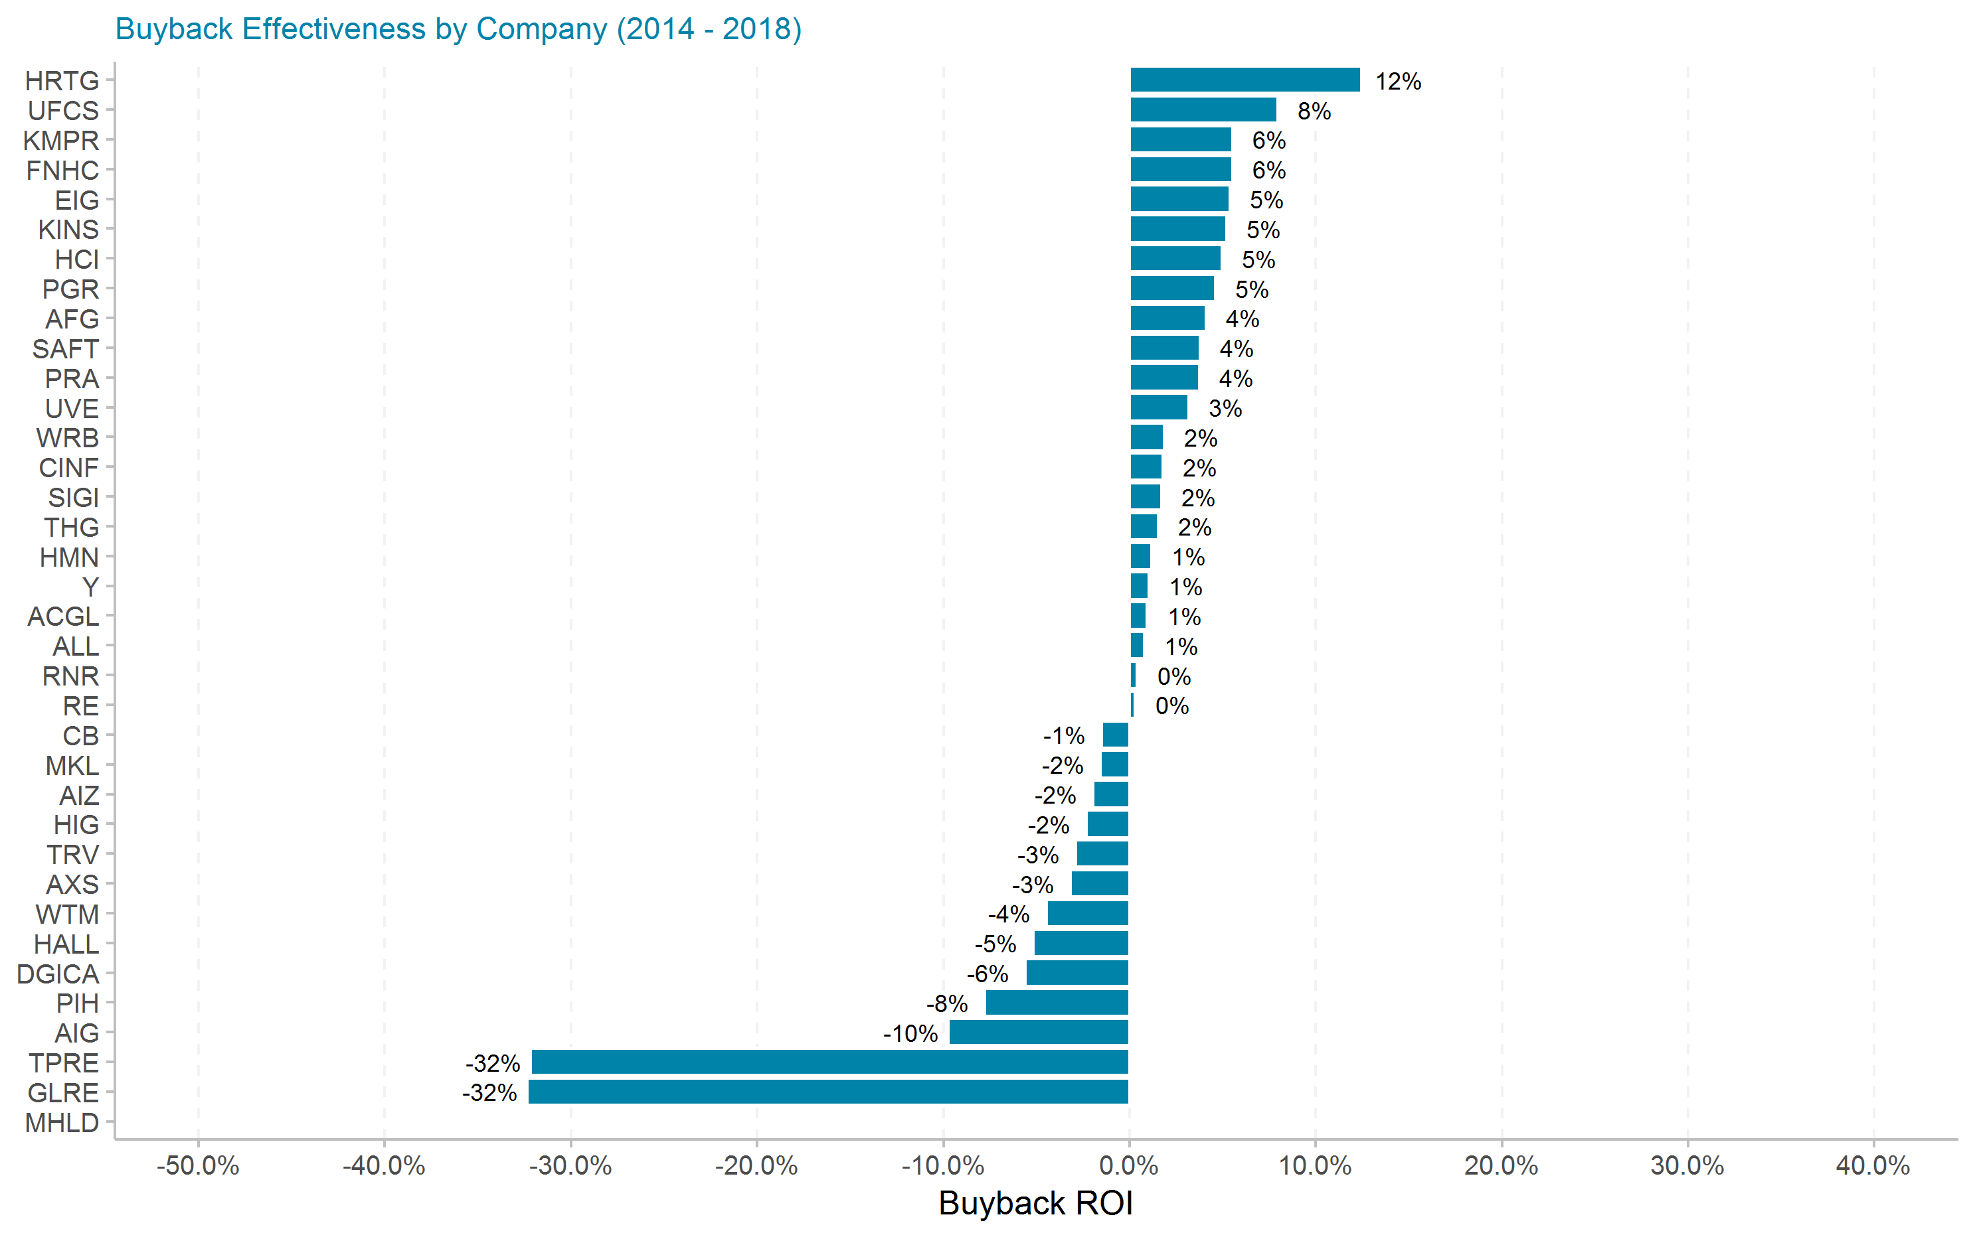
Buyback Effectiveness by Company

Slide 6
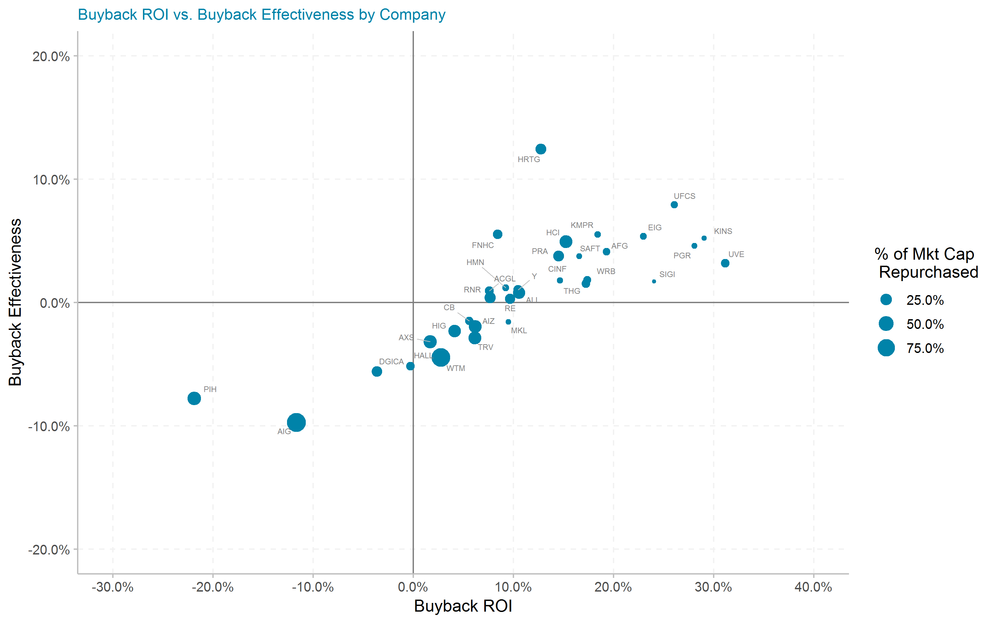
Buyback ROI vs. Buyback Effectiveness by Company

Slide 7
Top 25 most effective share repurchasers
Top 25 most effective share repurchasers
Ticker | # of quarters | Current Mkt Cap ($m) | Initial Shares (mil) | Shares Repurchased (mil) | Dollar Repurchased ($m) | Percent of Initial Shares Repurchased | Percent of Mkt Cap Repurchased | Total Shareholder Return | Buyback ROI | Buyback Effectiveness
HRTG | 19 | 448 | 29.8 | 7.2 | 90 | 24.2% | 20.1% | 0.3% | 12.7% | 12.4%
UFCS | 20 | 1,100 | 25.4 | 1.5 | 54 | 5.7% | 4.9% | 16.8% | 26.0% | 7.9%
KMPR | 20 | 5,000 | 55.4 | 4.7 | 170 | 8.5% | 3.4% | 12.2% | 18.4% | 5.5%
FNHC | 20 | 205 | 11.0 | 1.6 | 29 | 14.6% | 13.9% | 2.7% | 8.4% | 5.5%
EIG | 20 | 1,310 | 31.4 | 1.6 | 47 | 5.0% | 3.6% | 16.7% | 23.0% | 5.4%
KINS | 20 | 163 | 7.3 | 0.2 | 2 | 2.4% | 1.2% | 22.6% | 29.0% | 5.2%
HCI | 20 | 367 | 11.0 | 3.1 | 120 | 28.5% | 32.6% | 9.8% | 15.2% | 4.9%
PGR | 20 | 42,460 | 593.1 | 27.4 | 814 | 4.6% | 1.9% | 22.4% | 28.0% | 4.6%
AFG | 20 | 8,510 | 89.6 | 7.4 | 470 | 8.3% | 5.5% | 14.6% | 19.3% | 4.1%
SAFT | 20 | 1,330 | 15.5 | 0.5 | 23 | 3.0% | 1.8% | 12.3% | 16.5% | 3.8%
PRA | 20 | 1,880 | 59.5 | 8.6 | 394 | 14.5% | 21.0% | 10.4% | 14.5% | 3.8%
UVE | 20 | 1,070 | 34.8 | 5.0 | 100 | 14.5% | 9.4% | 27.1% | 31.1% | 3.2%
WRB | 20 | 10,240 | 127.6 | 13.8 | 668 | 10.8% | 6.5% | 15.2% | 17.4% | 1.8%
CINF | 20 | 13,810 | 163.0 | 5.1 | 331 | 3.1% | 2.4% | 12.6% | 14.6% | 1.8%
SIGI | 20 | 3,730 | 56.2 | 0.7 | 25 | 1.2% | 0.7% | 22.0% | 24.0% | 1.7%
THG | 20 | 4,620 | 43.8 | 4.9 | 401 | 11.1% | 8.7% | 15.4% | 17.2% | 1.5%
HMN | 20 | 1,440 | 40.6 | 1.7 | 56 | 4.3% | 3.9% | 7.9% | 9.2% | 1.2%
Y | 20 | 8,760 | 16.5 | 2.2 | 1,120 | 13.6% | 12.8% | 9.3% | 10.5% | 1.0%
ACGL | 20 | 12,870 | 402.3 | 60.6 | 1,288 | 15.1% | 10.0% | 6.6% | 7.6% | 0.9%
ALL | 20 | 31,200 | 434.0 | 133.2 | 8,777 | 30.7% | 28.1% | 9.7% | 10.6% | 0.8%
RNR | 20 | 6,080 | 40.9 | 12.2 | 1,312 | 29.9% | 21.6% | 7.2% | 7.6% | 0.4%
RE | 20 | 8,740 | 46.1 | 8.4 | 1,462 | 18.2% | 16.7% | 9.3% | 9.7% | 0.3%
CB | 20 | 62,650 | 338.0 | 39.4 | 4,690 | 11.7% | 7.5% | 7.2% | 5.6% | -1.5%
MKL | 20 | 13,680 | 14.0 | 0.2 | 185 | 1.6% | 1.4% | 11.2% | 9.5% | -1.6%
AIZ | 20 | 5,830 | 71.9 | 23.2 | 1,894 | 32.3% | 32.5% | 8.3% | 6.2% | -2.0%

Slide 8
By Company Detail

Slide 9
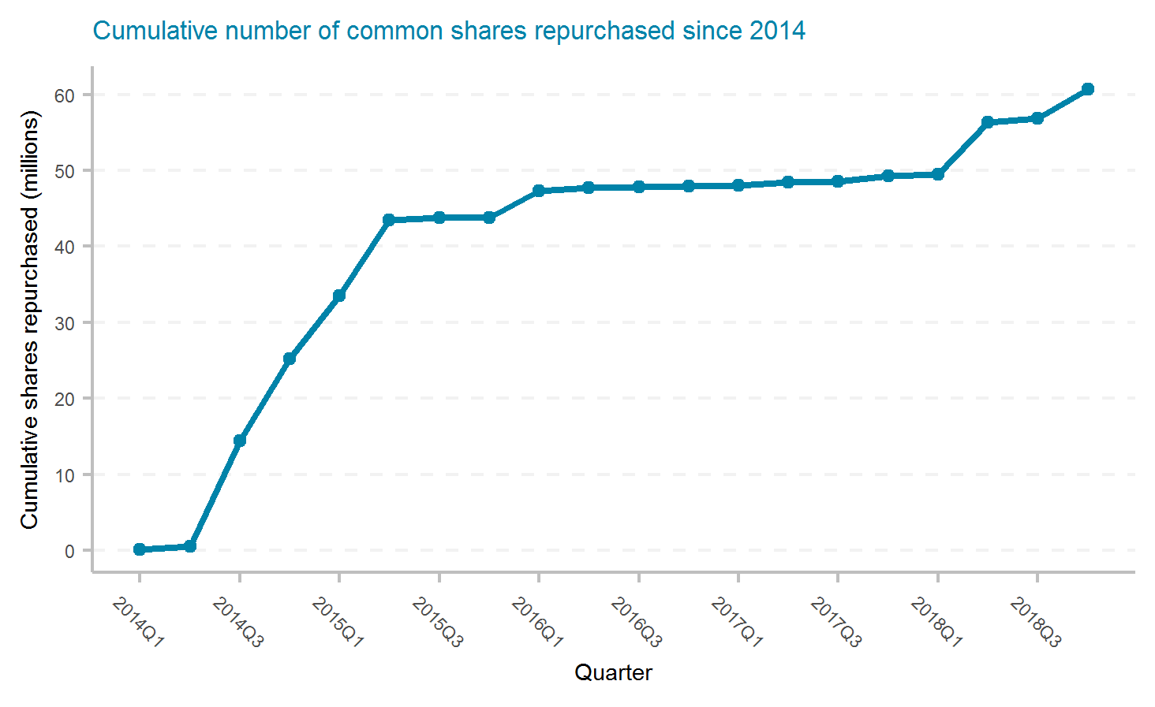
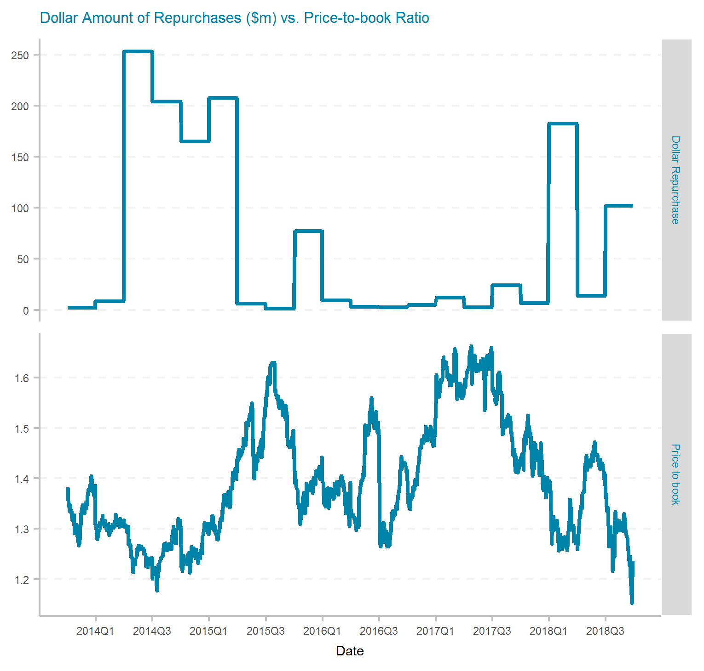
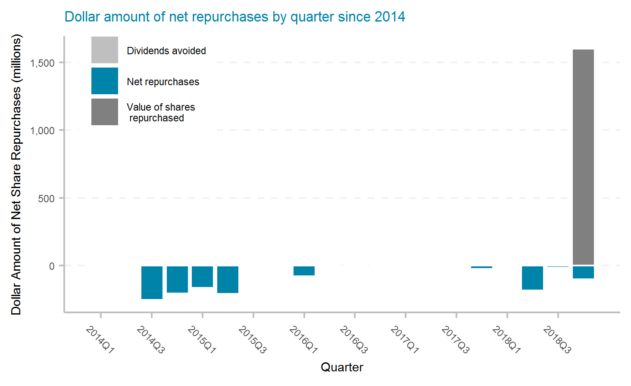
Arch Capital Group Ltd.
Ticker | # of quarters | Current Mkt Cap ($m) | Initial Shares (mil) | Shares Repurchased (mil) | Dollar Repurchased ($m) | Percent of Initial Shares Repurchased | Percent of Mkt Cap Repurchased | Total Shareholder Return | Buyback ROI | Buyback Effectiveness
ACGL | 20 | 12,870 | 402.3 | 60.6 | 1,288 | 15.1% | 10.0% | 6.6% | 7.6% | 0.9%

Slide 10
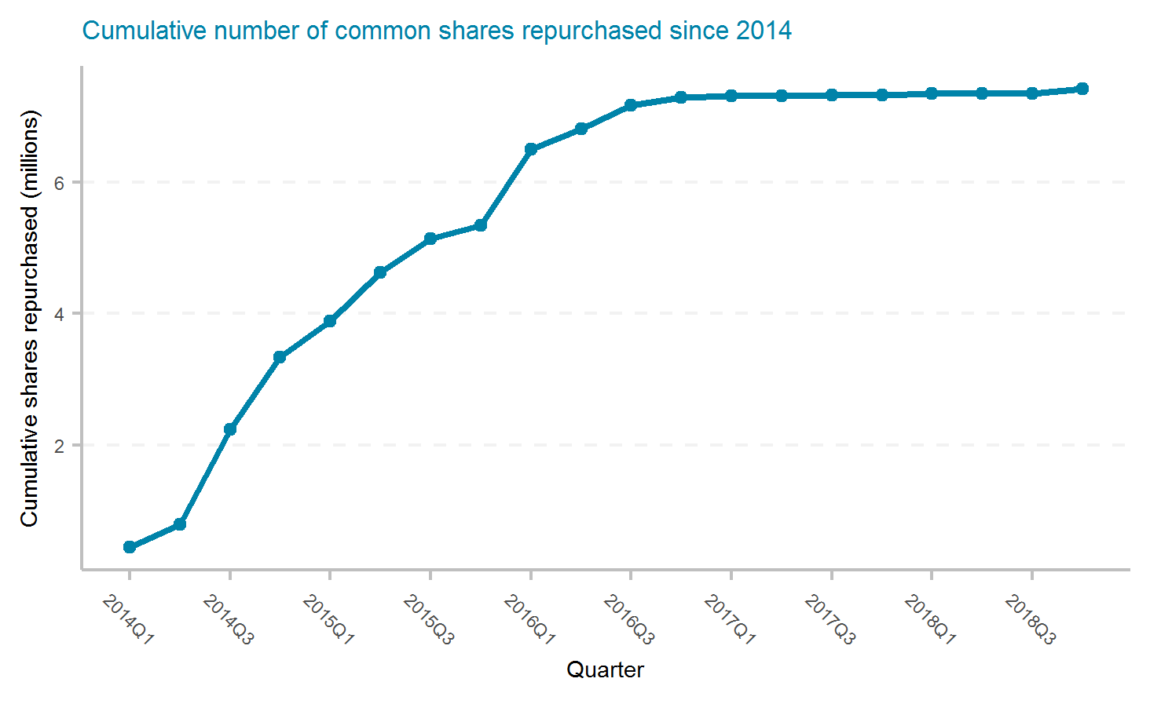
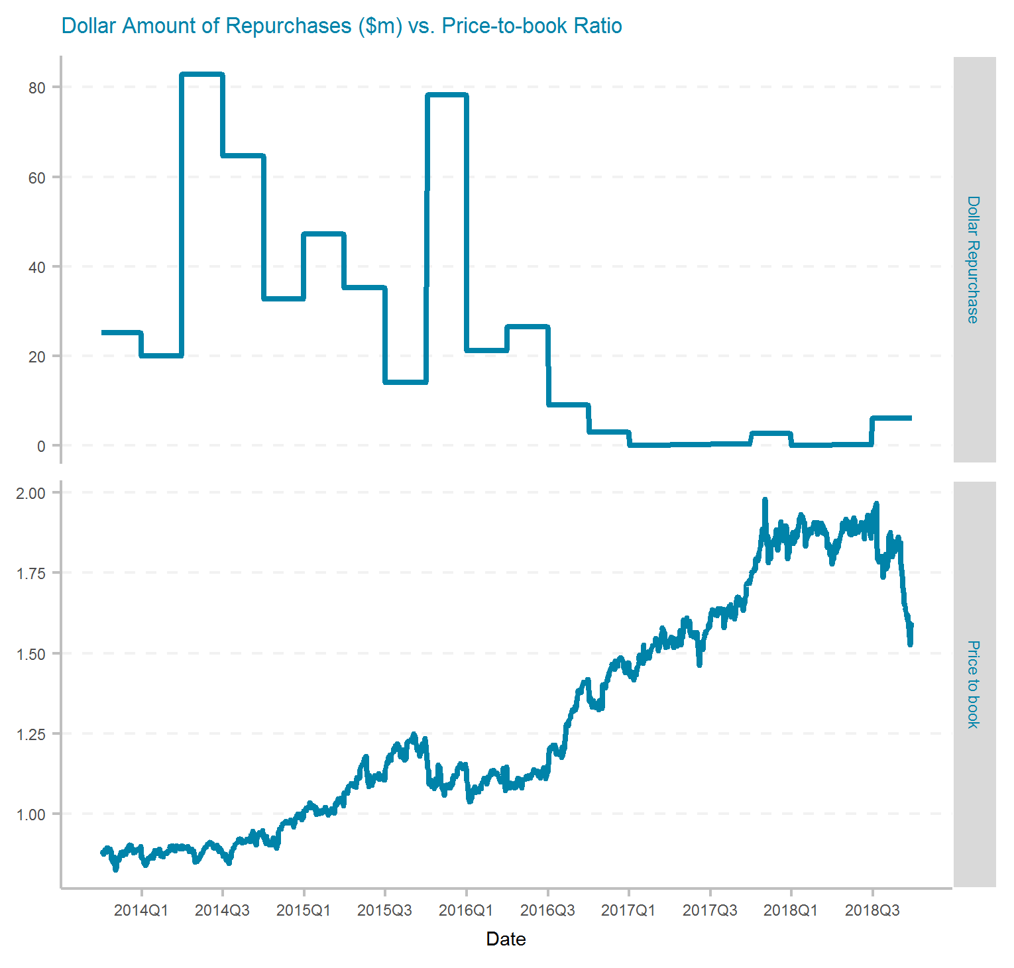
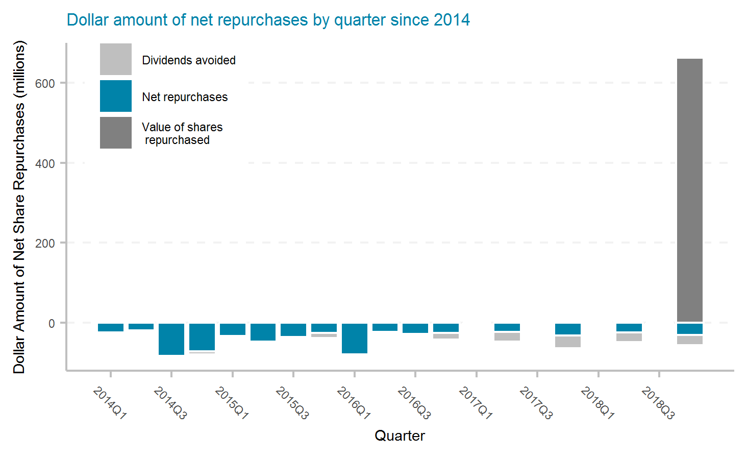
American Financial Group, Inc.
Ticker | # of quarters | Current Mkt Cap ($m) | Initial Shares (mil) | Shares Repurchased (mil) | Dollar Repurchased ($m) | Percent of Initial Shares Repurchased | Percent of Mkt Cap Repurchased | Total Shareholder Return | Buyback ROI | Buyback Effectiveness
AFG | 20 | 8,510 | 89.6 | 7.4 | 470 | 8.3% | 5.5% | 14.6% | 19.3% | 4.1%

Slide 11
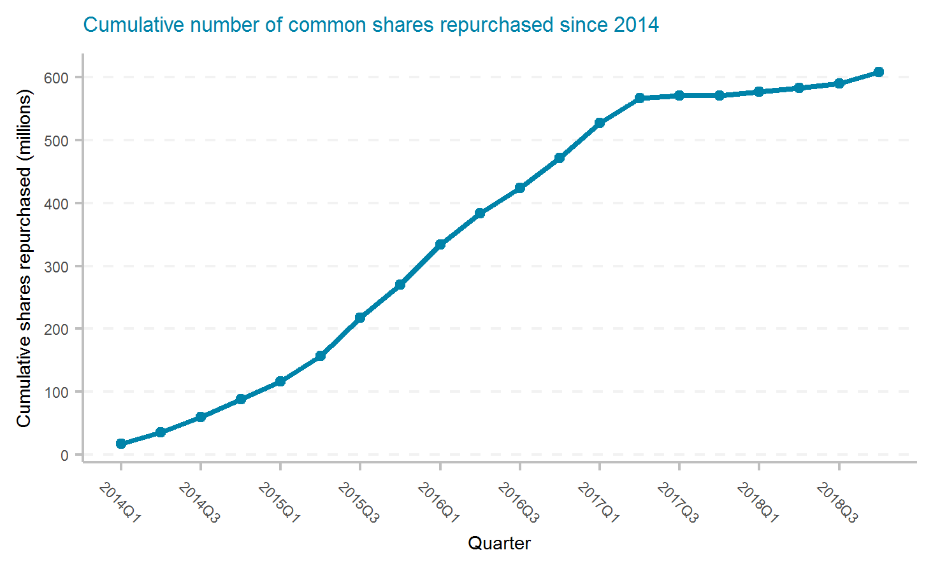
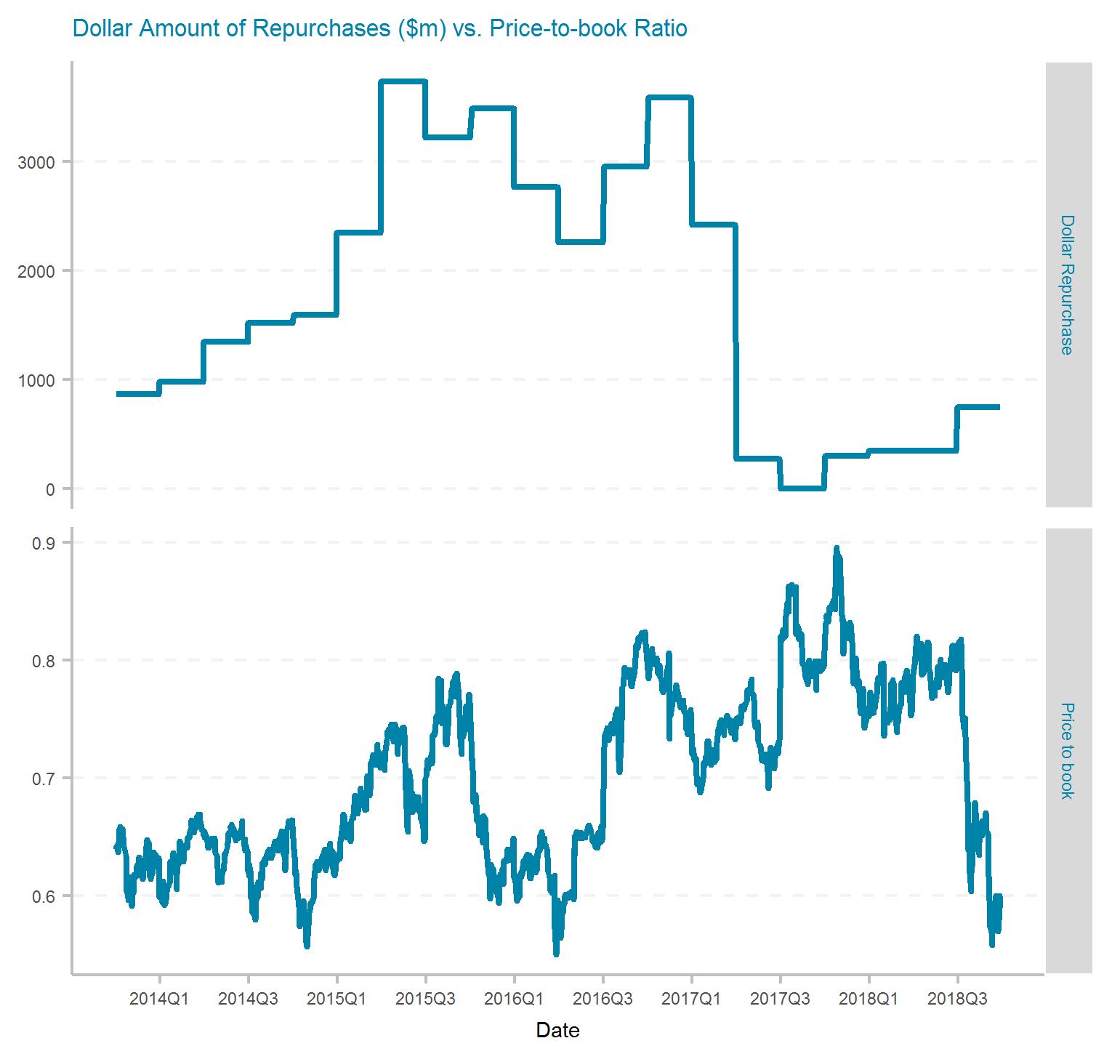
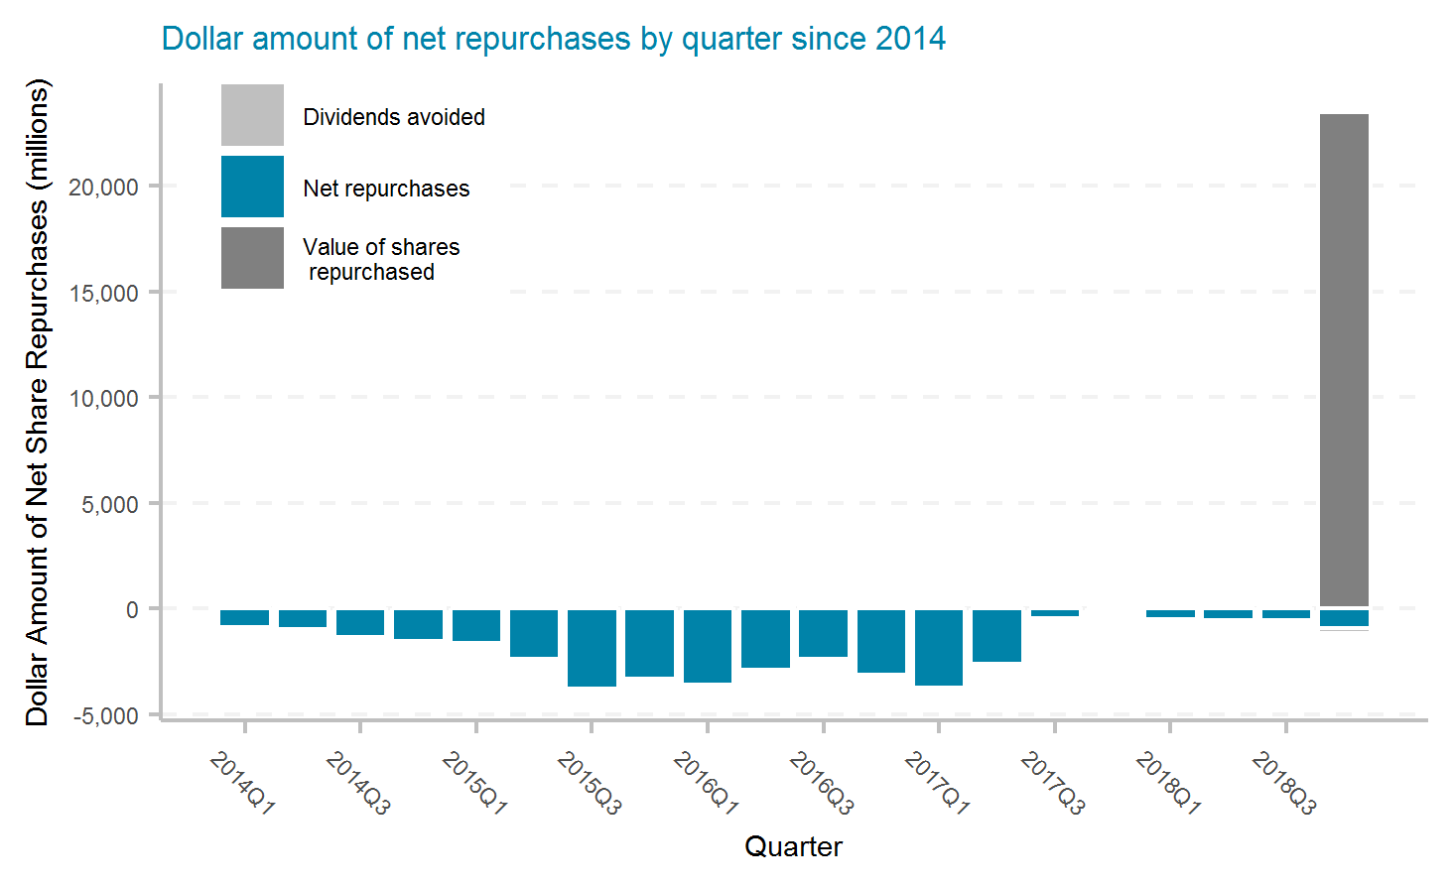
American International Group, Inc.
Ticker | # of quarters | Current Mkt Cap ($m) | Initial Shares (mil) | Shares Repurchased (mil) | Dollar Repurchased ($m) | Percent of Initial Shares Repurchased | Percent of Mkt Cap Repurchased | Total Shareholder Return | Buyback ROI | Buyback Effectiveness
AIG | 20 | 36,910 | 1,446.6 | 607.4 | 35,068 | 42.0% | 95.0% | -2.2% | -11.7% | -9.7%

Slide 12
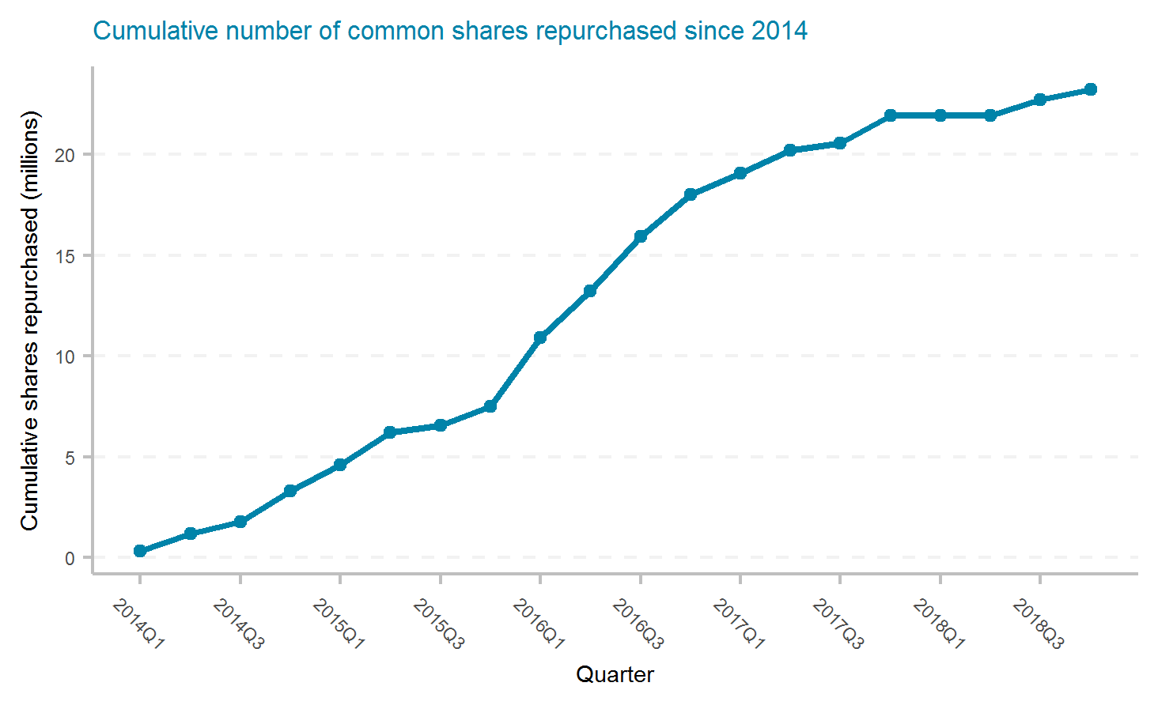
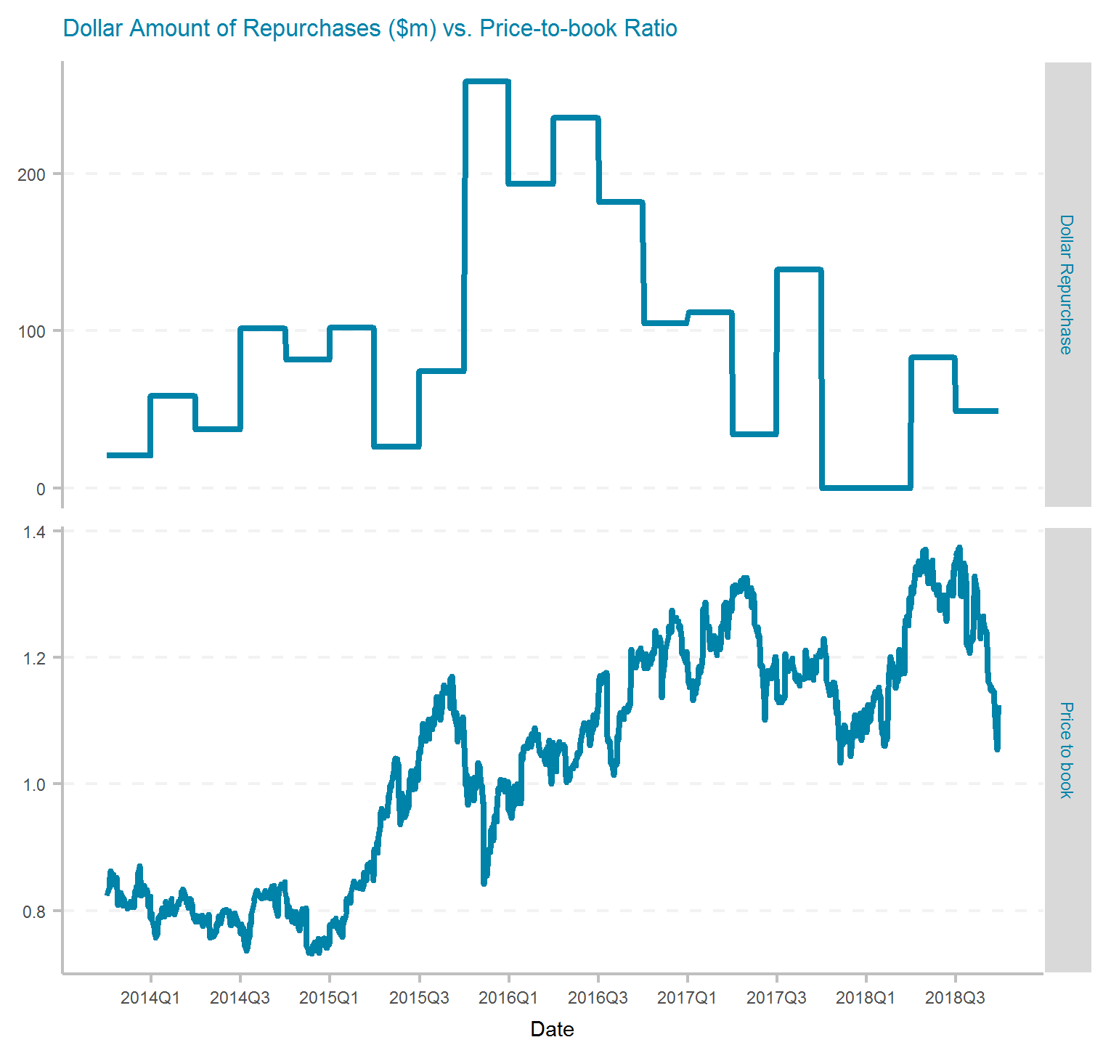
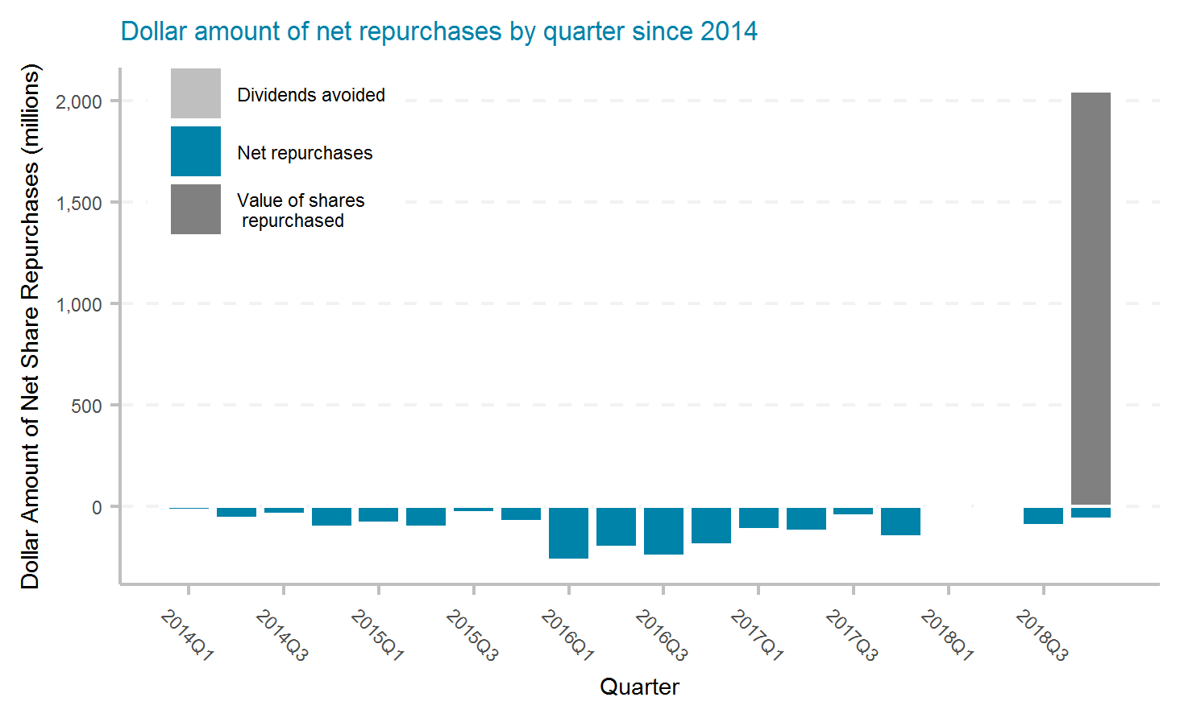
Assurant, Inc.
Ticker | # of quarters | Current Mkt Cap ($m) | Initial Shares (mil) | Shares Repurchased (mil) | Dollar Repurchased ($m) | Percent of Initial Shares Repurchased | Percent of Mkt Cap Repurchased | Total Shareholder Return | Buyback ROI | Buyback Effectiveness
AIZ | 20 | 5,830 | 71.9 | 23.2 | 1,894 | 32.3% | 32.5% | 8.3% | 6.2% | -2.0%

Slide 13
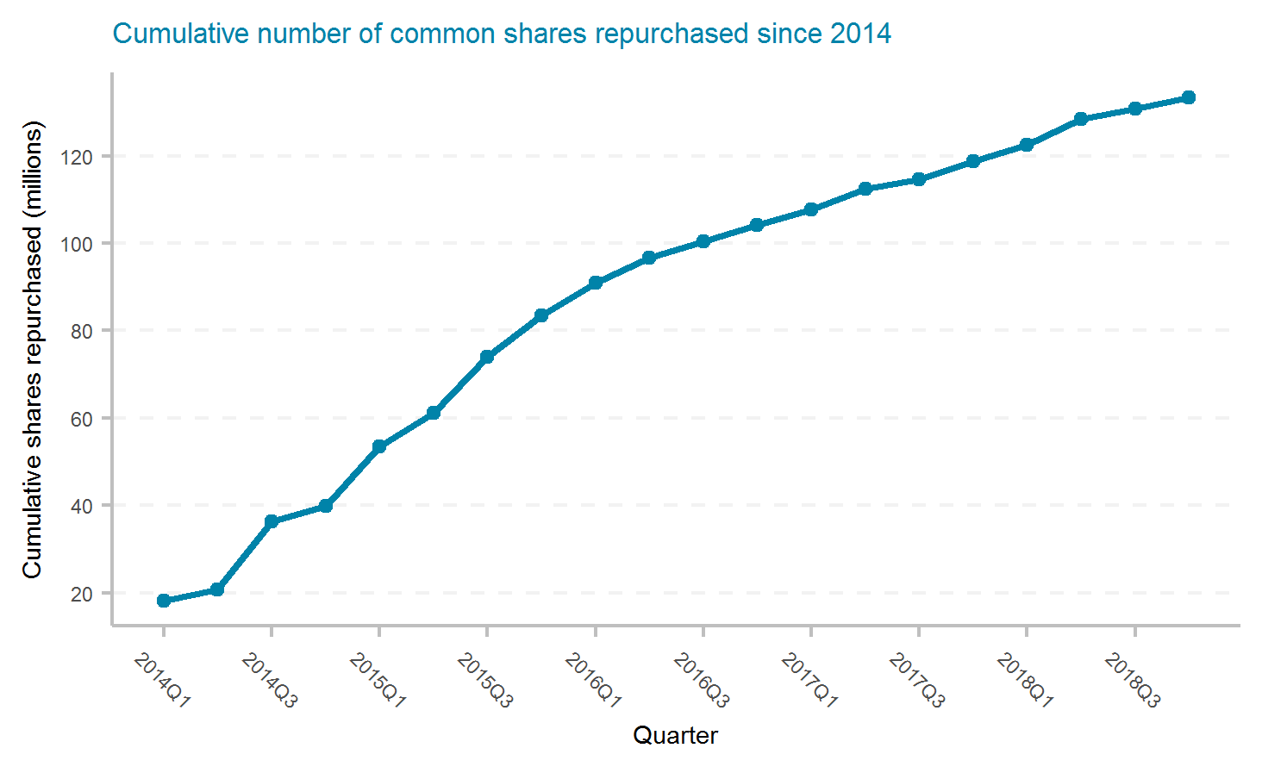
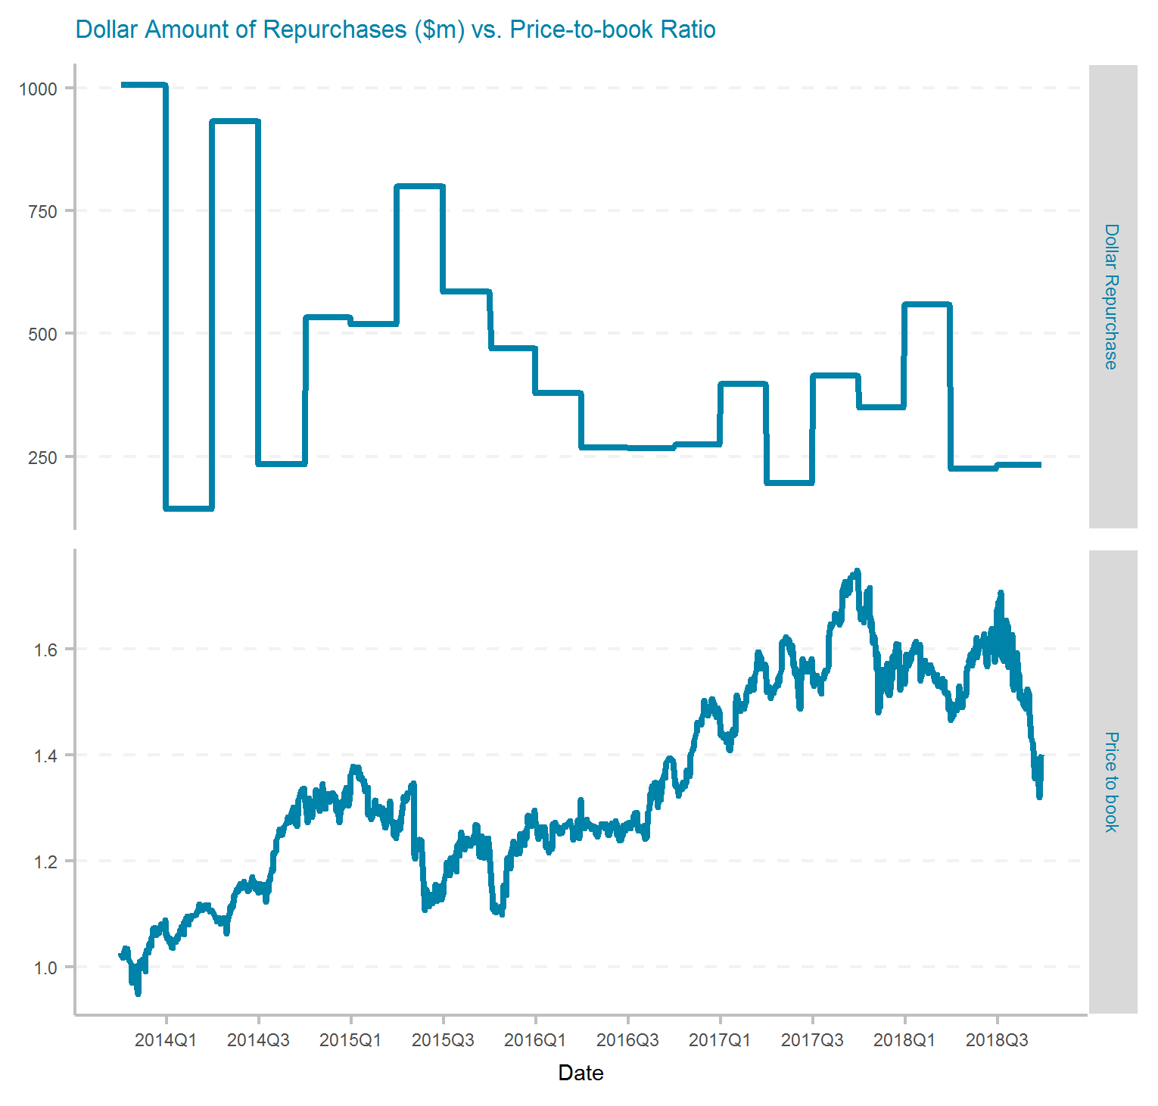
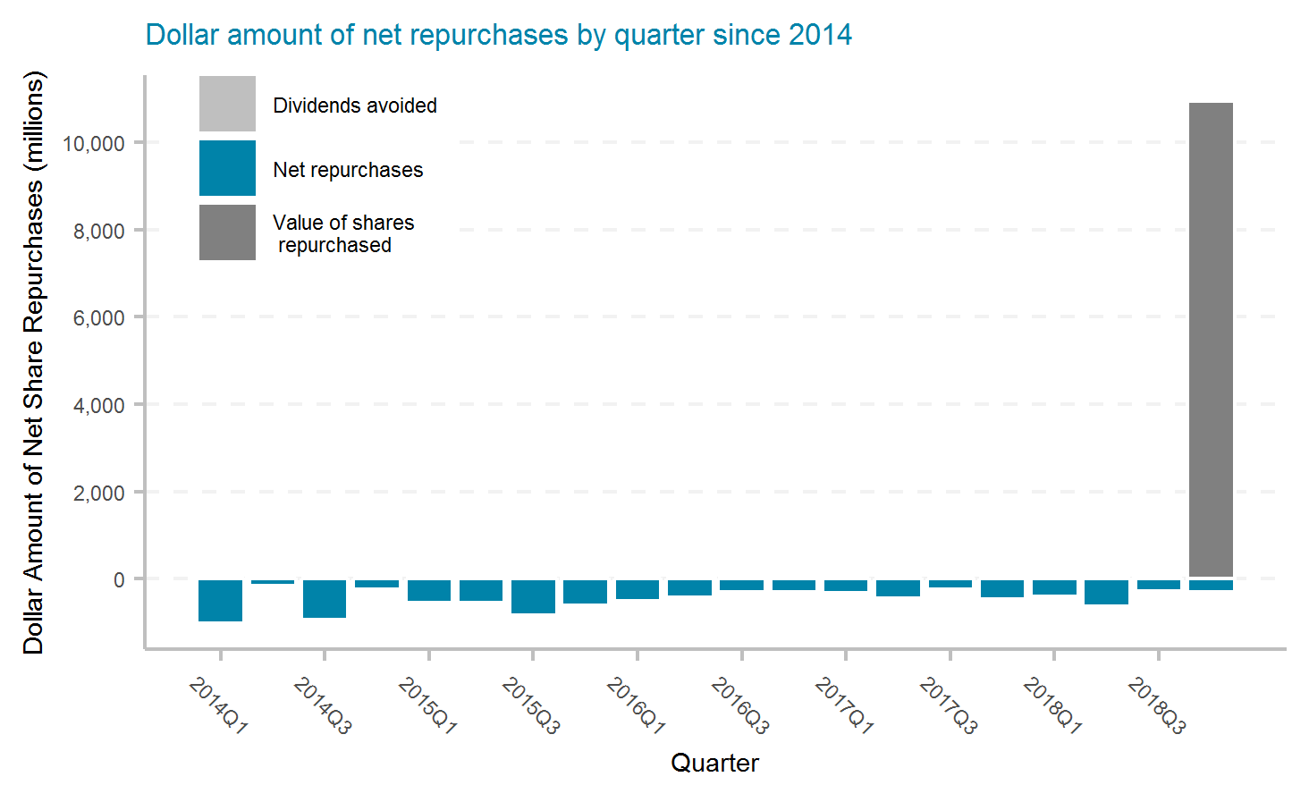
Allstate Corporation
Ticker | # of quarters | Current Mkt Cap ($m) | Initial Shares (mil) | Shares Repurchased (mil) | Dollar Repurchased ($m) | Percent of Initial Shares Repurchased | Percent of Mkt Cap Repurchased | Total Shareholder Return | Buyback ROI | Buyback Effectiveness
ALL | 20 | 31,200 | 434.0 | 133.2 | 8,777 | 30.7% | 28.1% | 9.7% | 10.6% | 0.8%

Slide 14
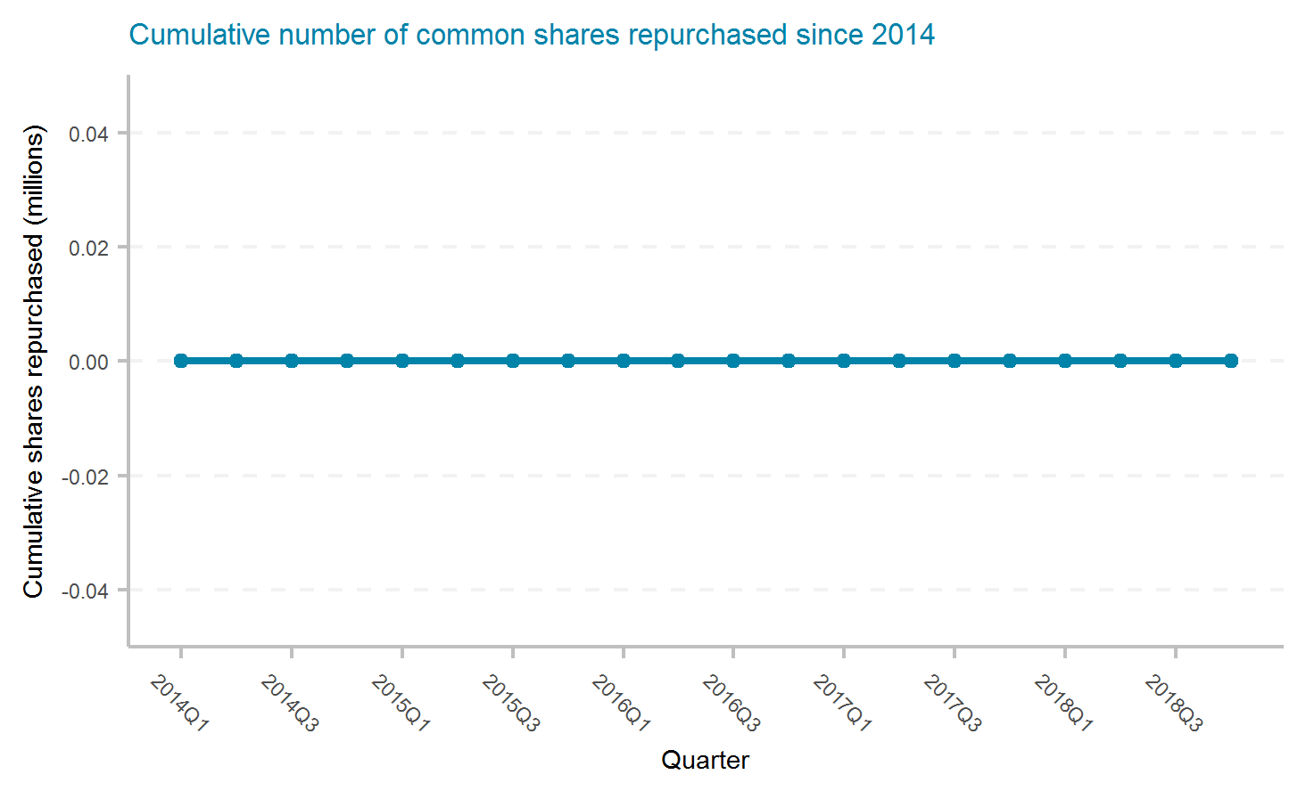
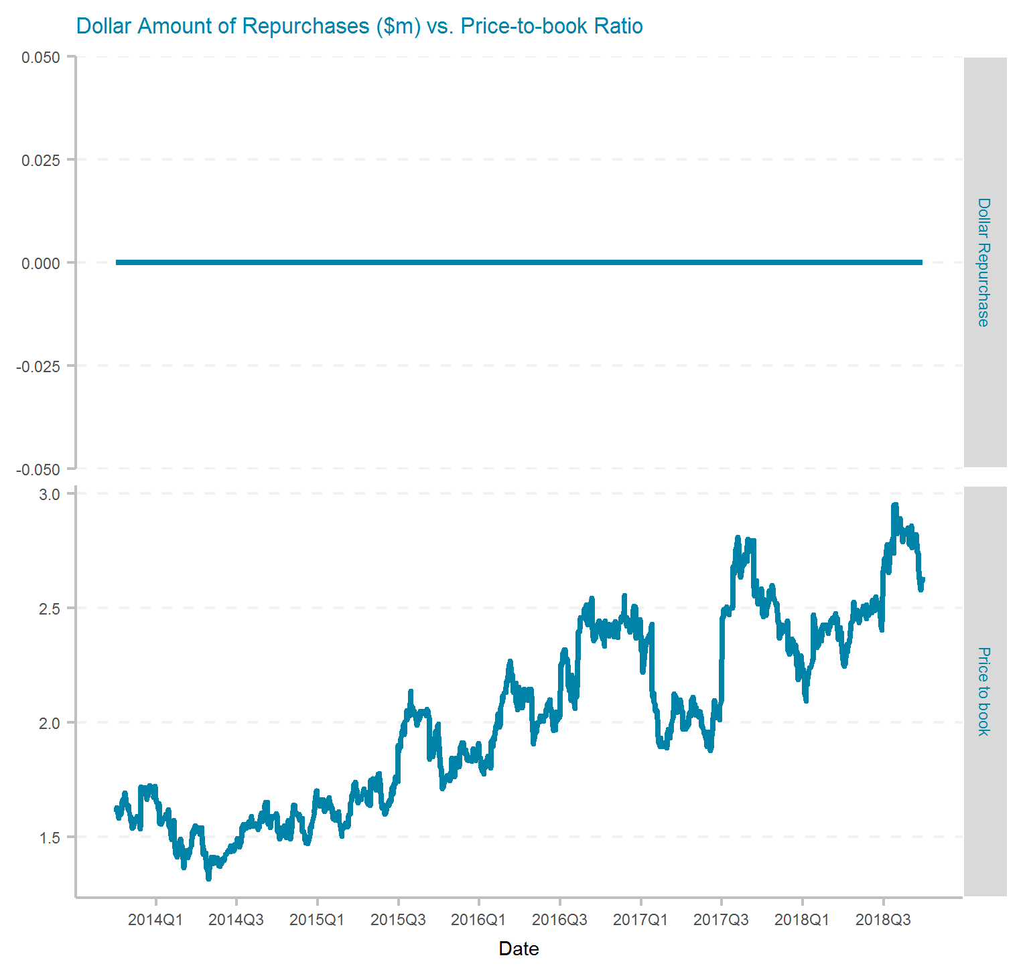
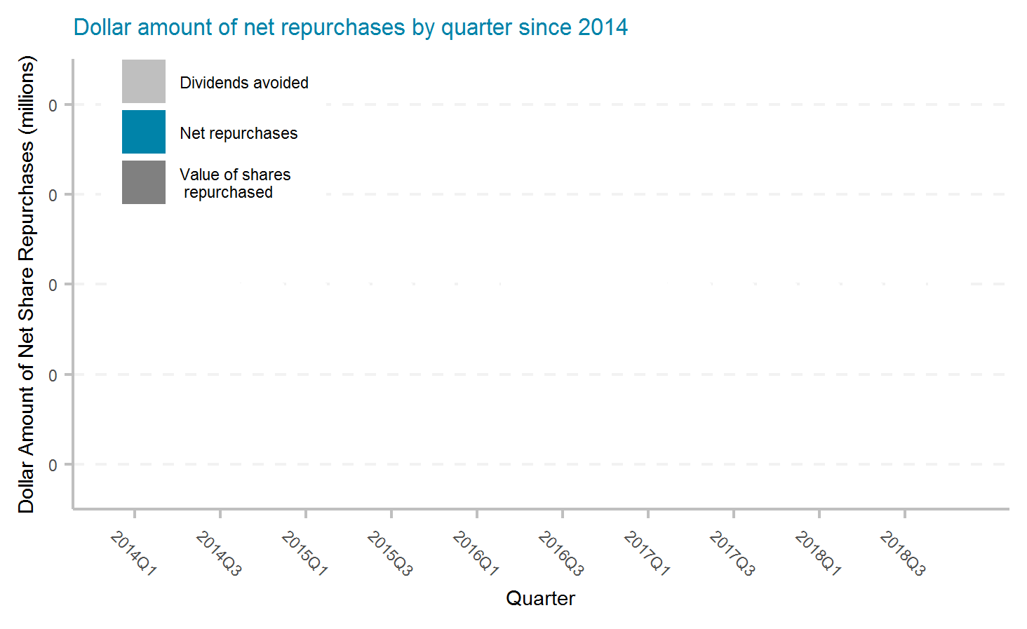
AMERISAFE, Inc.
Ticker | # of quarters | Current Mkt Cap ($m) | Initial Shares (mil) | Shares Repurchased (mil) | Dollar Repurchased ($m) | Percent of Initial Shares Repurchased | Percent of Mkt Cap Repurchased | Total Shareholder Return | Buyback ROI | Buyback Effectiveness

Slide 15
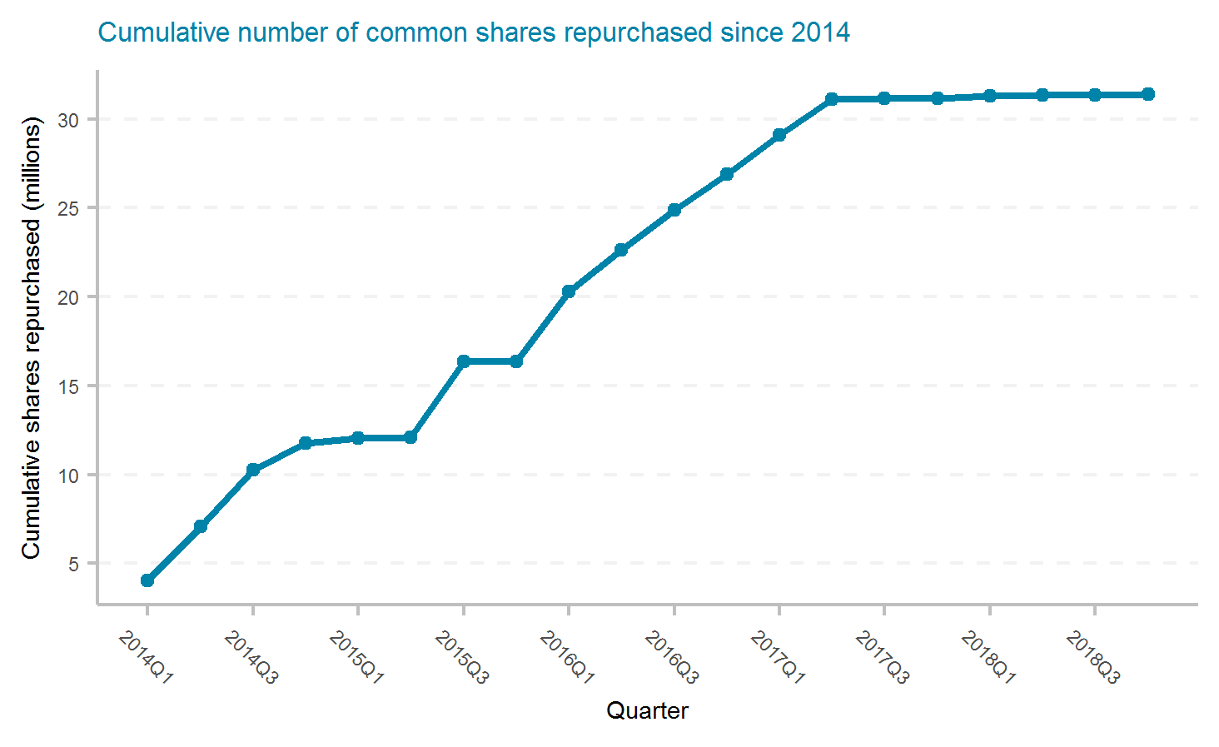
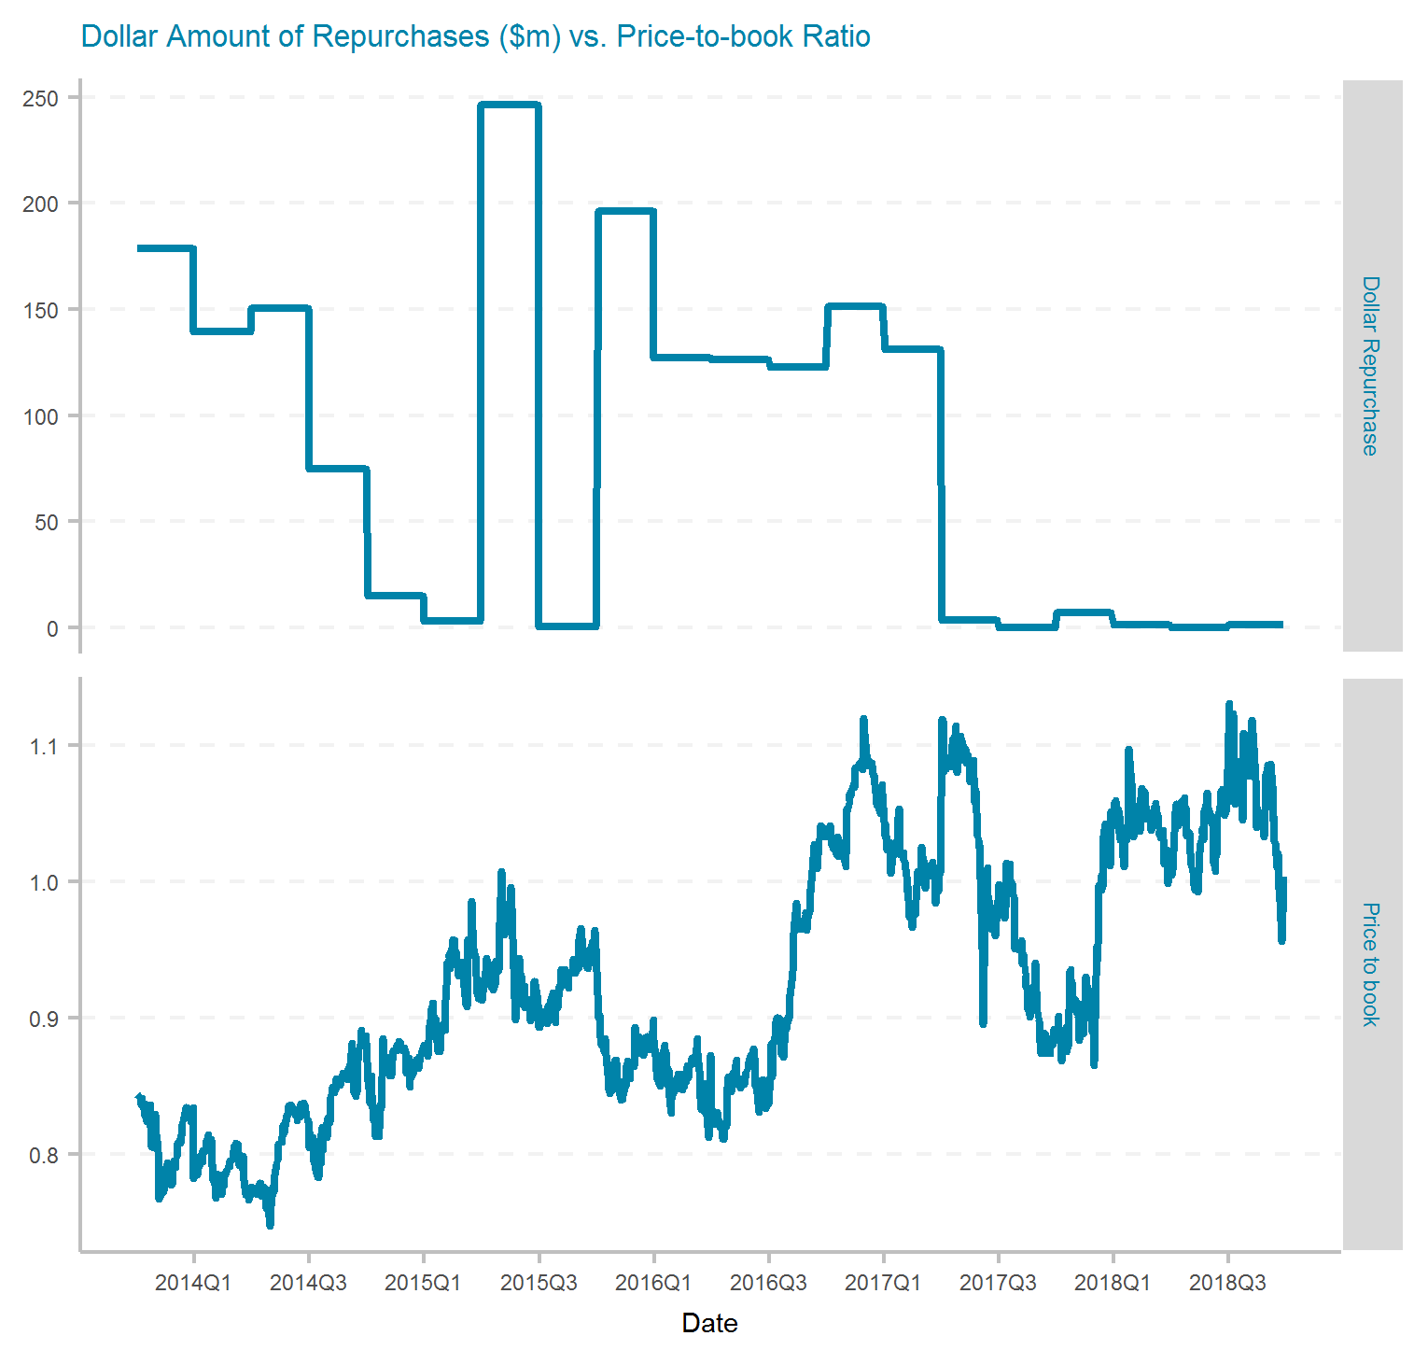
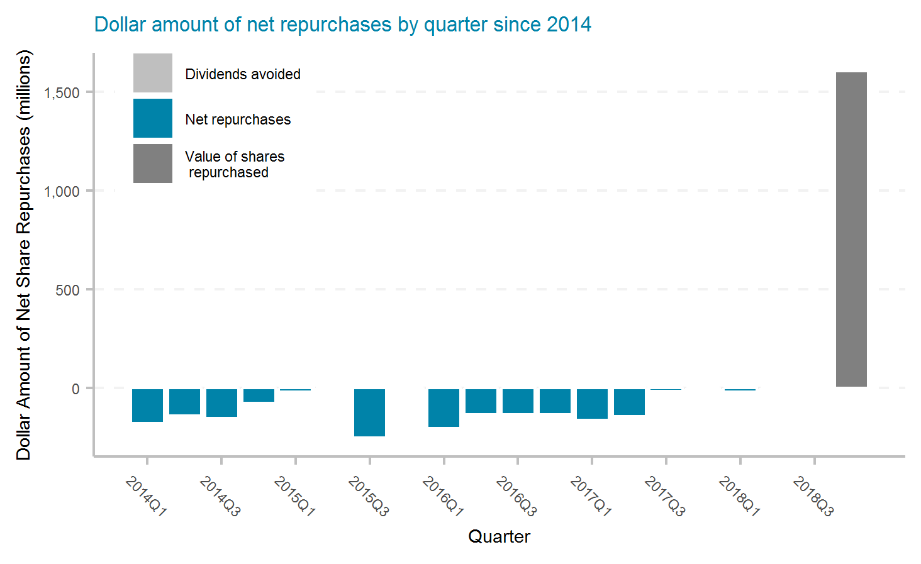
AXIS Capital Holdings Limited
Ticker | # of quarters | Current Mkt Cap ($m) | Initial Shares (mil) | Shares Repurchased (mil) | Dollar Repurchased ($m) | Percent of Initial Shares Repurchased | Percent of Mkt Cap Repurchased | Total Shareholder Return | Buyback ROI | Buyback Effectiveness
AXS | 20 | 4,650 | 106.7 | 31.4 | 1,675 | 29.4% | 36.0% | 5.0% | 1.7% | -3.2%

Slide 16
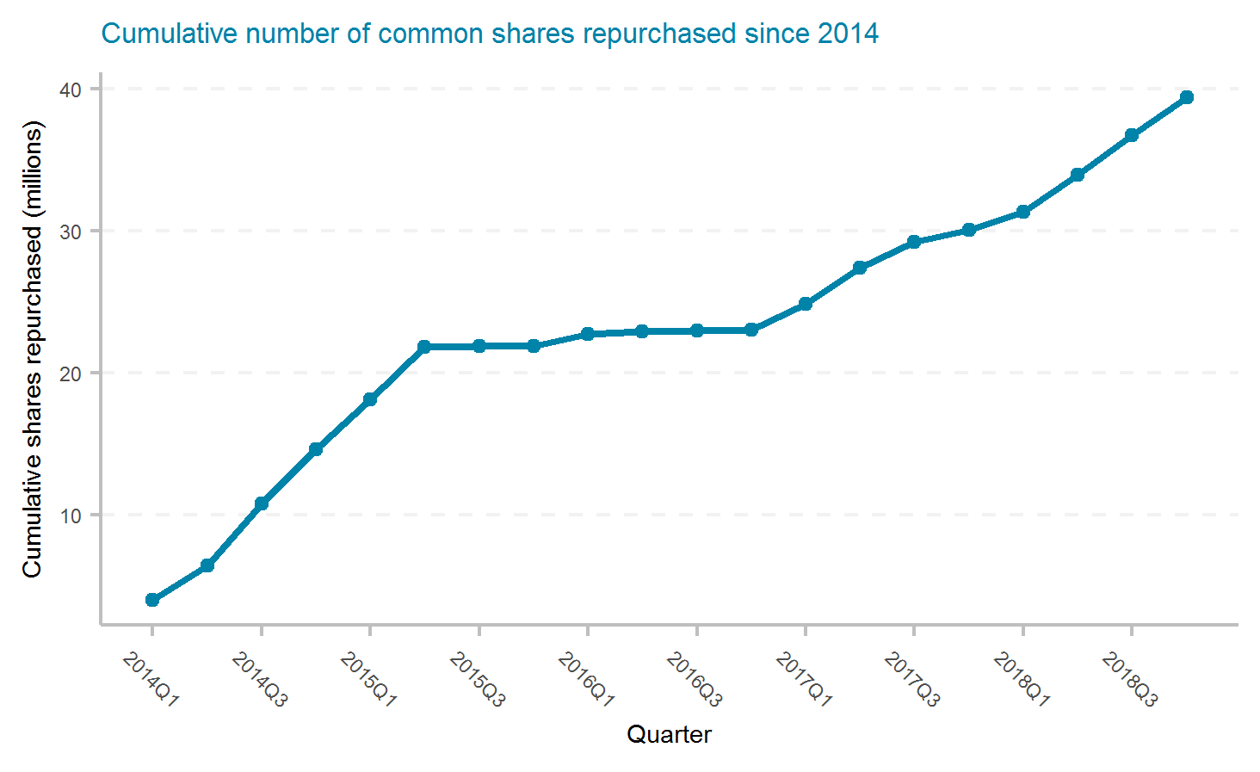
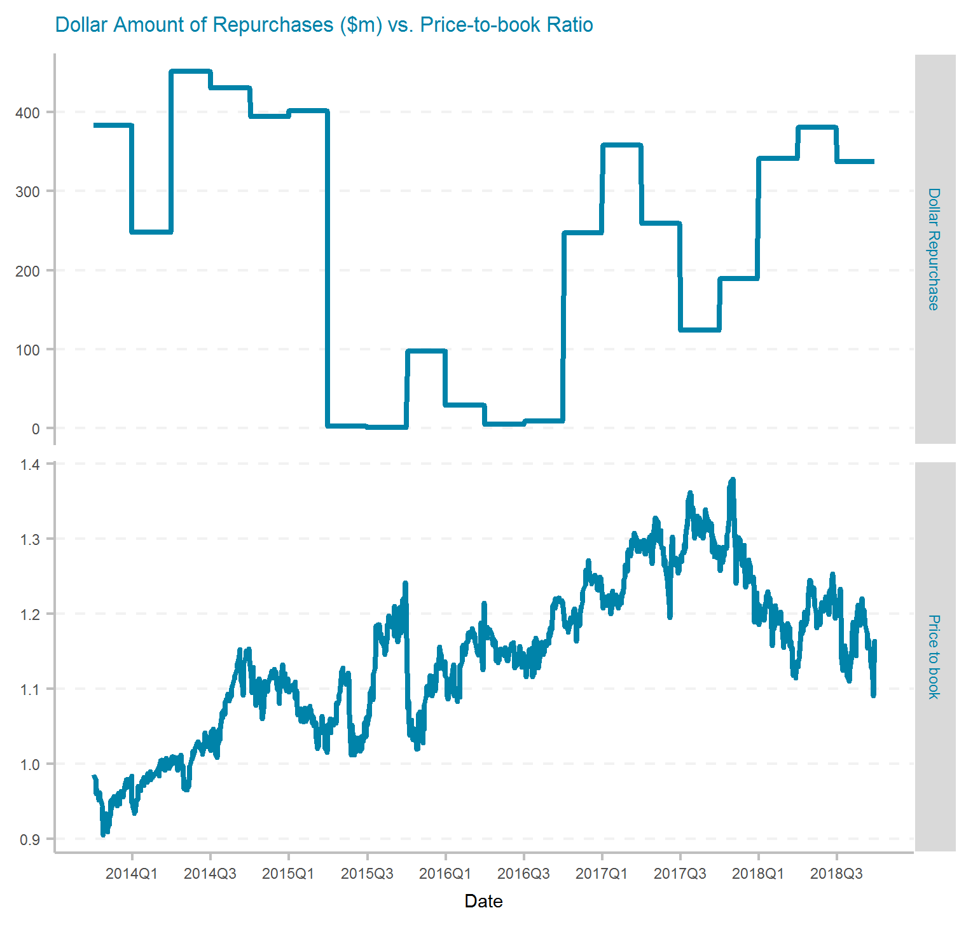
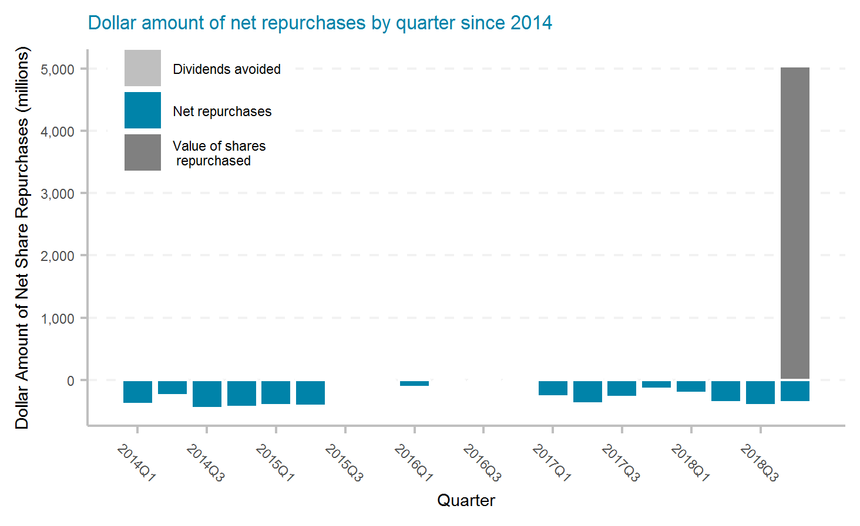
Chubb Limited
Ticker | # of quarters | Current Mkt Cap ($m) | Initial Shares (mil) | Shares Repurchased (mil) | Dollar Repurchased ($m) | Percent of Initial Shares Repurchased | Percent of Mkt Cap Repurchased | Total Shareholder Return | Buyback ROI | Buyback Effectiveness
CB | 20 | 62,650 | 338.0 | 39.4 | 4,690 | 11.7% | 7.5% | 7.2% | 5.6% | -1.5%

Slide 17
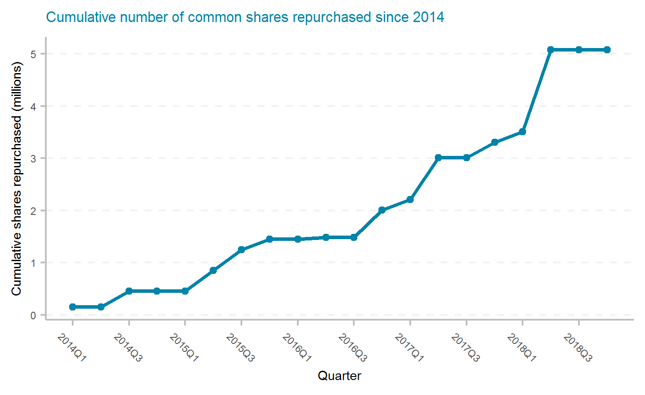
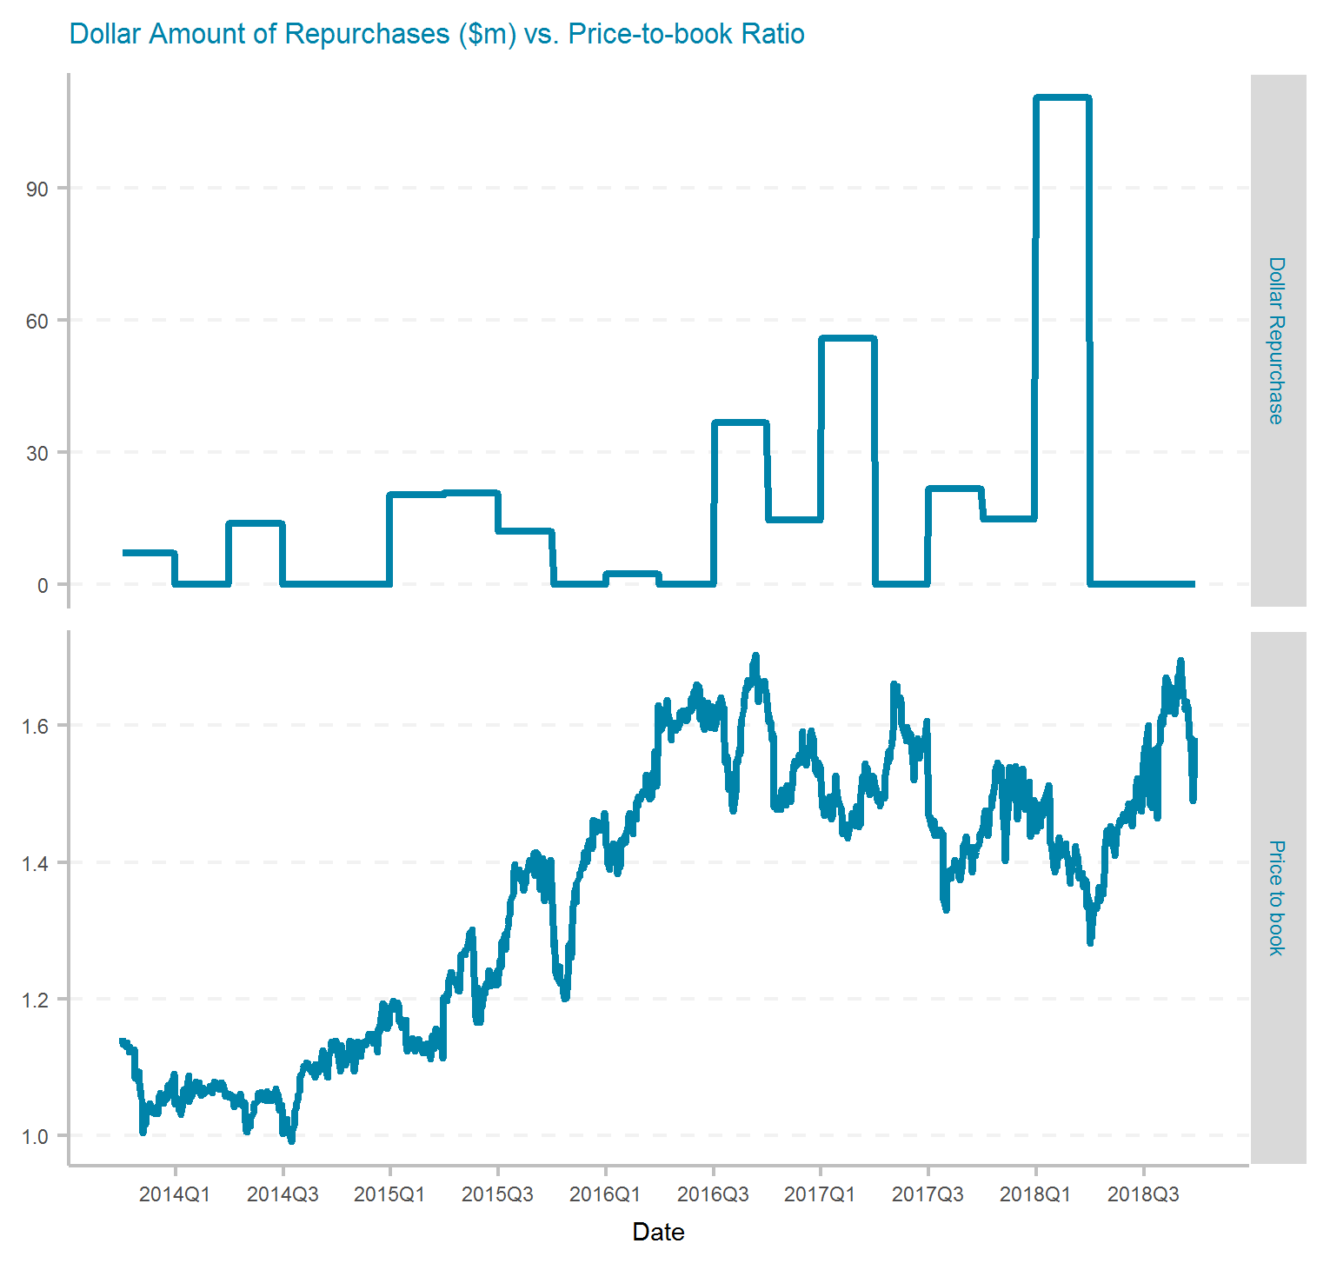
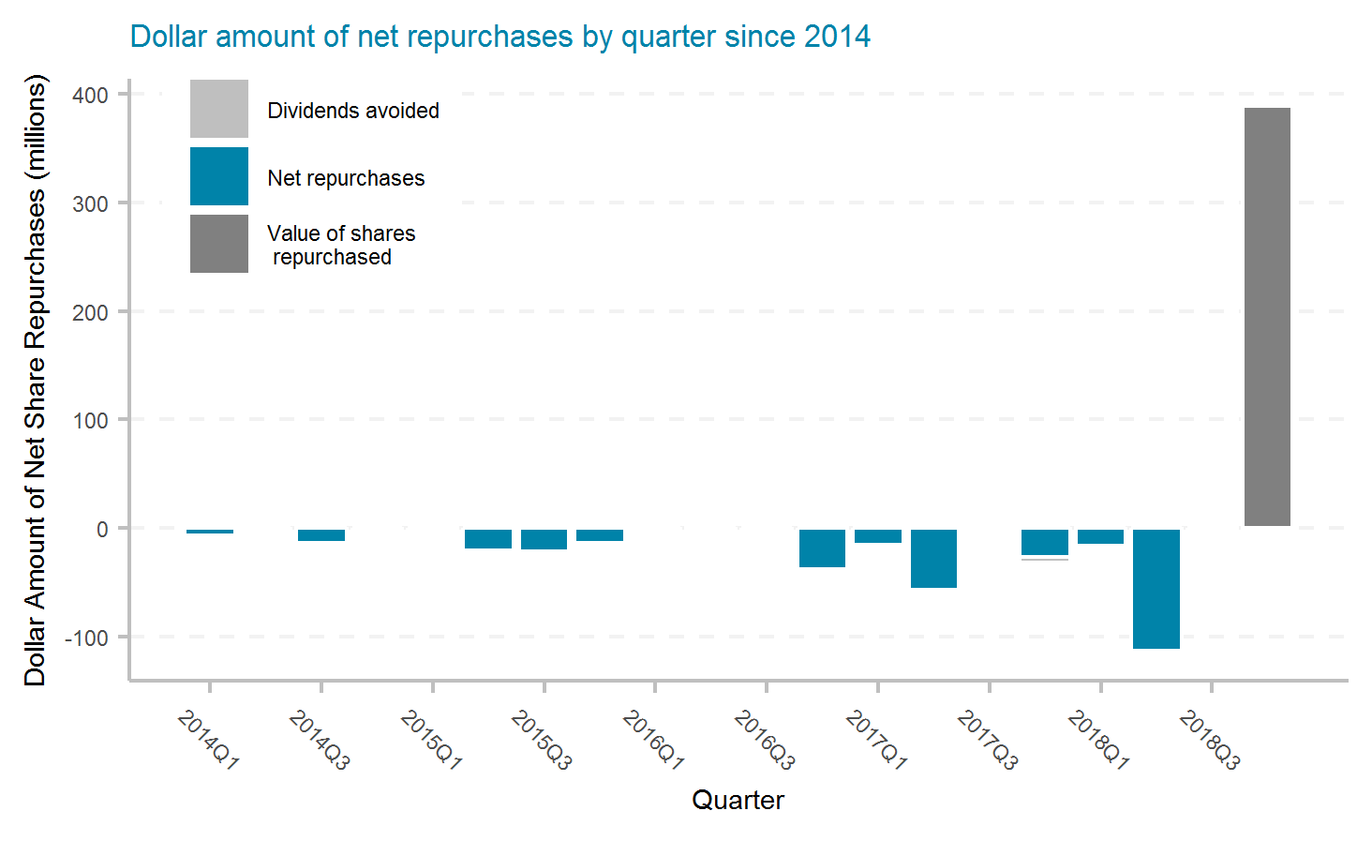
Cincinnati Financial Corporation
Ticker | # of quarters | Current Mkt Cap ($m) | Initial Shares (mil) | Shares Repurchased (mil) | Dollar Repurchased ($m) | Percent of Initial Shares Repurchased | Percent of Mkt Cap Repurchased | Total Shareholder Return | Buyback ROI | Buyback Effectiveness
CINF | 20 | 13,810 | 163.0 | 5.1 | 331 | 3.1% | 2.4% | 12.6% | 14.6% | 1.8%

Slide 18
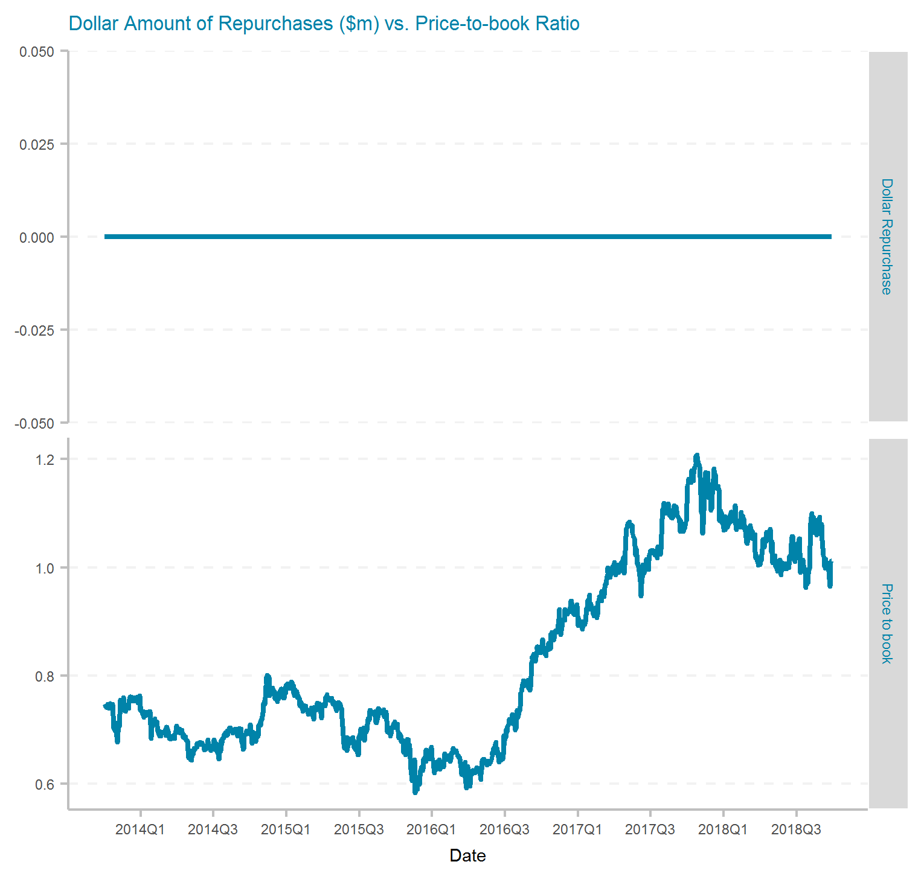
CNA Financial Corporation
Ticker | # of quarters | Current Mkt Cap ($m) | Initial Shares (mil) | Shares Repurchased (mil) | Dollar Repurchased ($m) | Percent of Initial Shares Repurchased | Percent of Mkt Cap Repurchased | Total Shareholder Return | Buyback ROI | Buyback Effectiveness

Slide 19
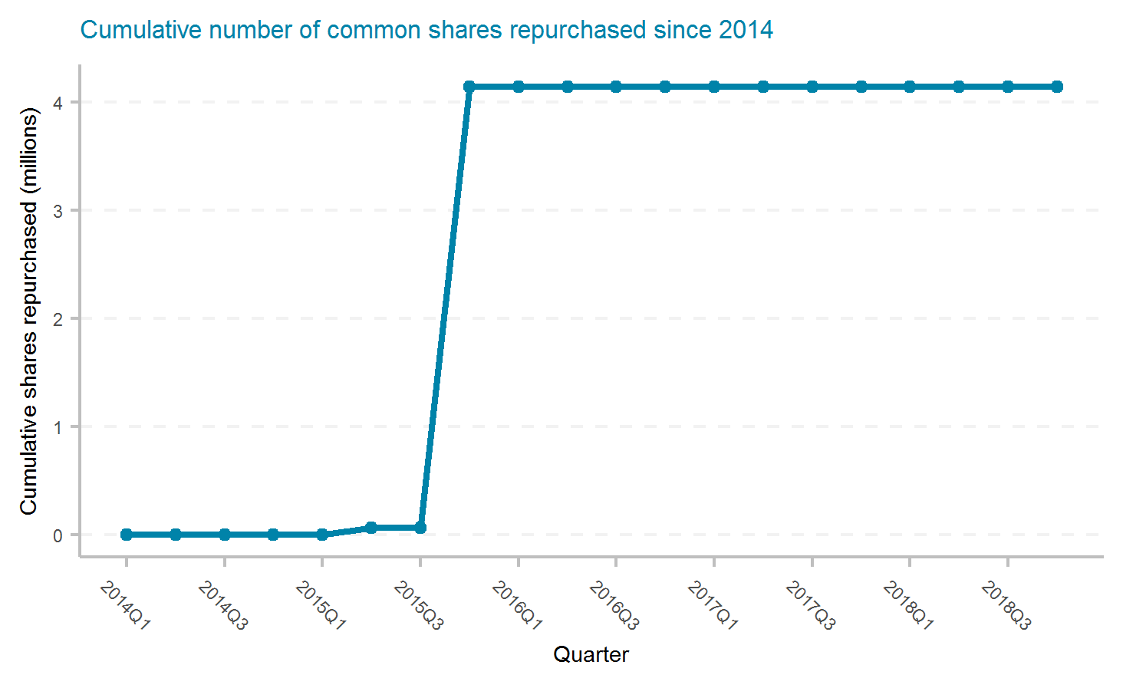
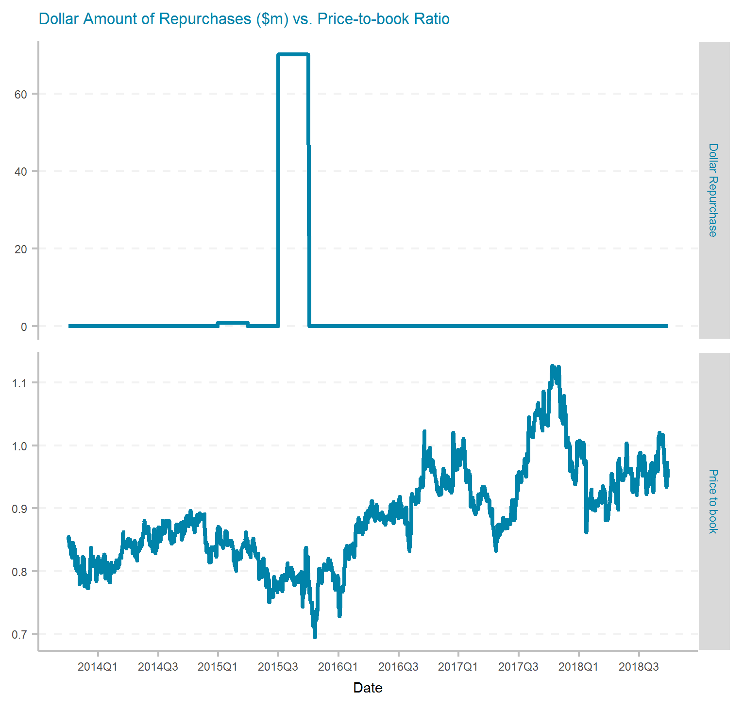
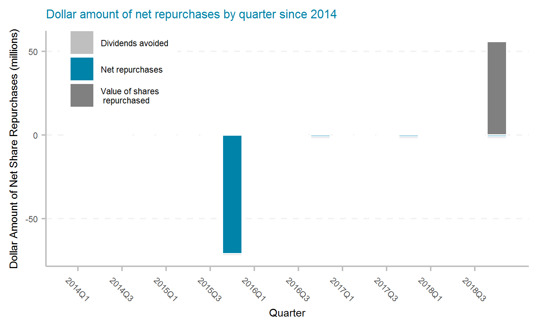
Donegal Group Inc.
Ticker | # of quarters | Current Mkt Cap ($m) | Initial Shares (mil) | Shares Repurchased (mil) | Dollar Repurchased ($m) | Percent of Initial Shares Repurchased | Percent of Mkt Cap Repurchased | Total Shareholder Return | Buyback ROI | Buyback Effectiveness
DGICA | 20 | 381 | 26.5 | 4.1 | 71 | 15.6% | 18.6% | 2.0% | -3.7% | -5.6%

Slide 20
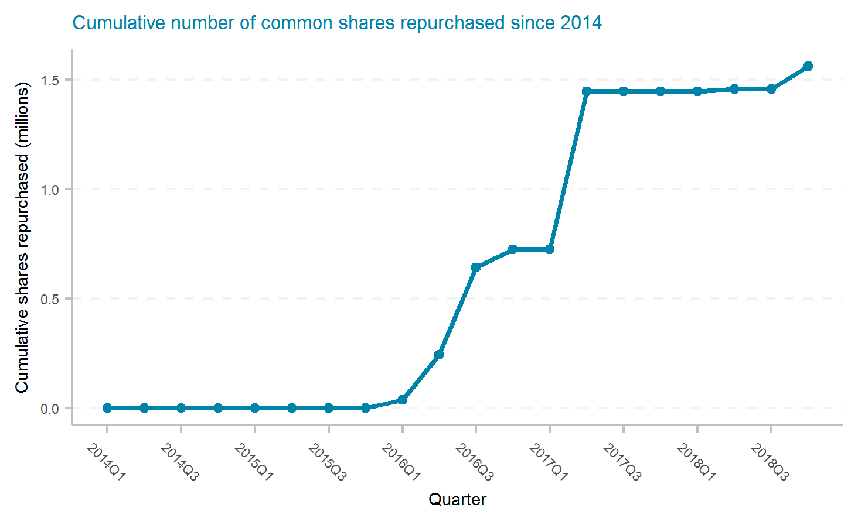
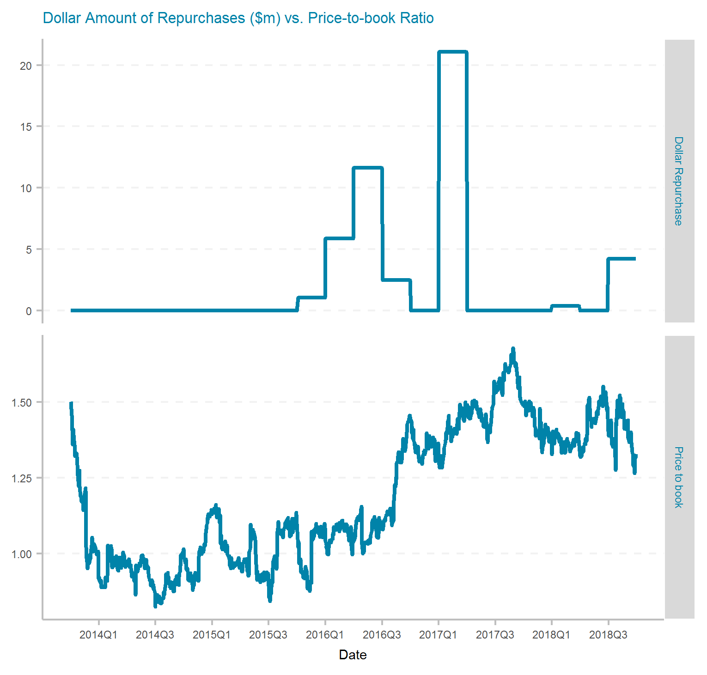
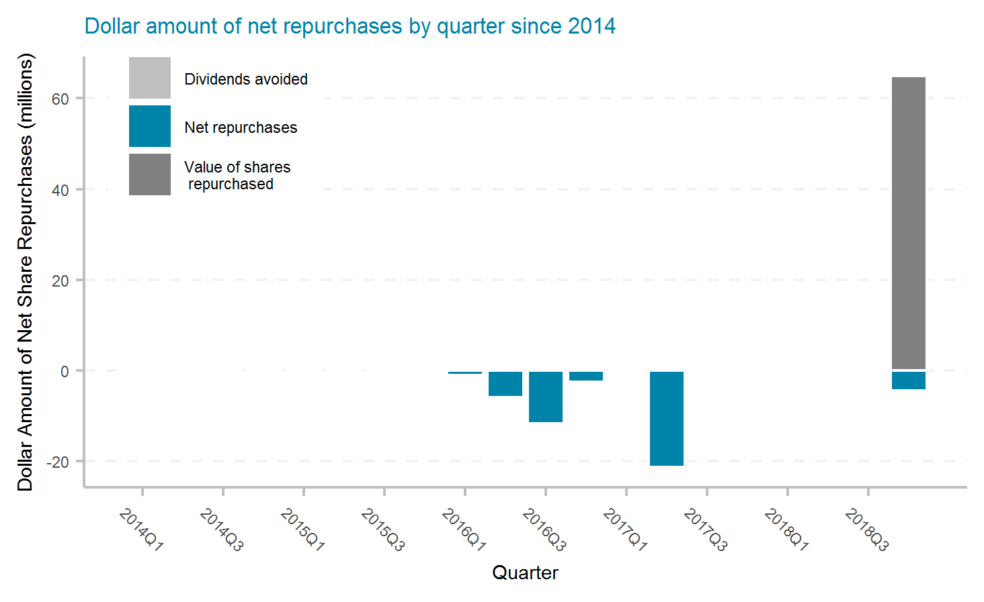
Employers Holdings, Inc.
Ticker | # of quarters | Current Mkt Cap ($m) | Initial Shares (mil) | Shares Repurchased (mil) | Dollar Repurchased ($m) | Percent of Initial Shares Repurchased | Percent of Mkt Cap Repurchased | Total Shareholder Return | Buyback ROI | Buyback Effectiveness
EIG | 20 | 1,310 | 31.4 | 1.6 | 47 | 5.0% | 3.6% | 16.7% | 23.0% | 5.4%

Slide 21
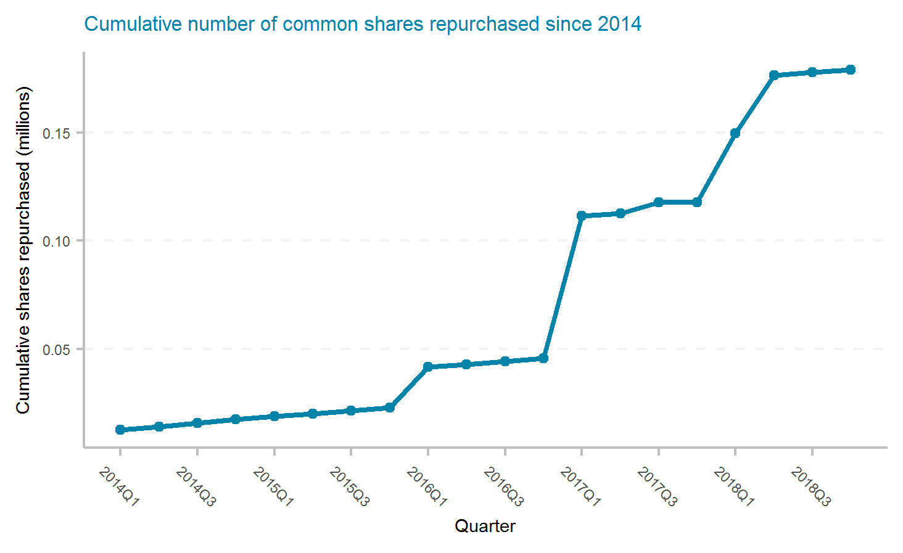
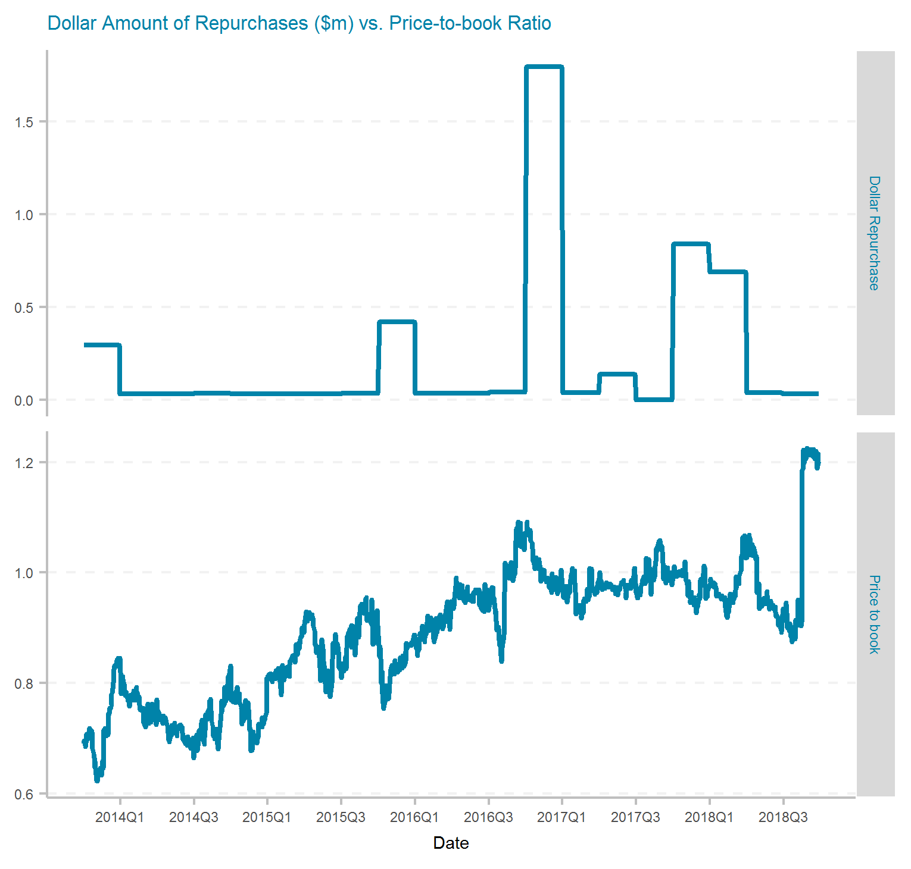
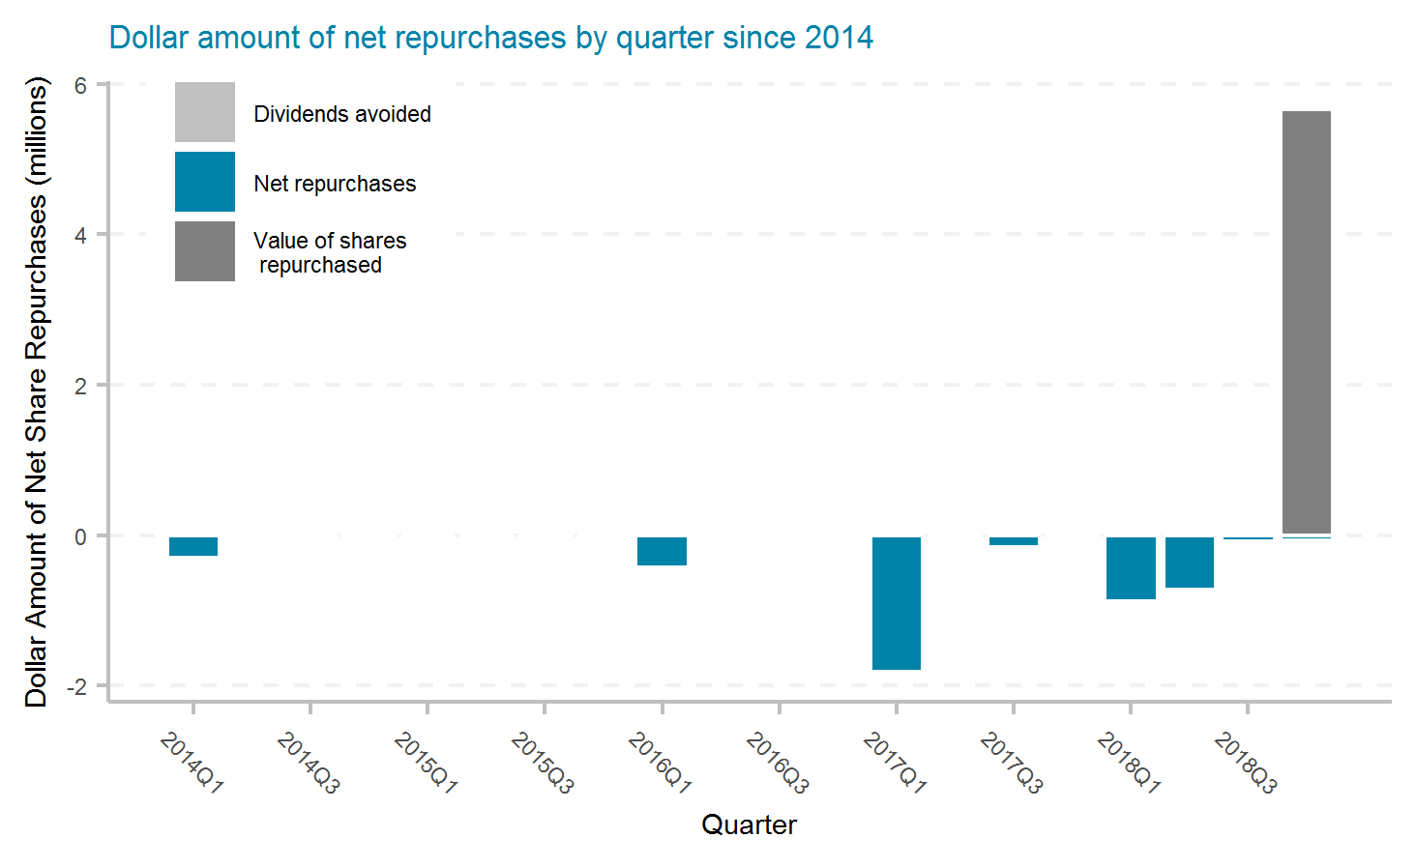
EMC Insurance Group Inc.
Ticker | # of quarters | Current Mkt Cap ($m) | Initial Shares (mil) | Shares Repurchased (mil) | Dollar Repurchased ($m) | Percent of Initial Shares Repurchased | Percent of Mkt Cap Repurchased | Total Shareholder Return | Buyback ROI | Buyback Effectiveness

Slide 22
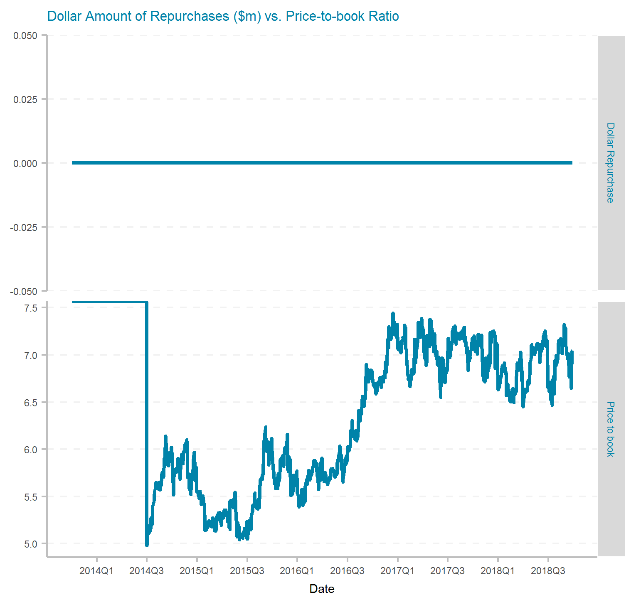
Erie Indemnity Company
Ticker | # of quarters | Current Mkt Cap ($m) | Initial Shares (mil) | Shares Repurchased (mil) | Dollar Repurchased ($m) | Percent of Initial Shares Repurchased | Percent of Mkt Cap Repurchased | Total Shareholder Return | Buyback ROI | Buyback Effectiveness

Slide 23
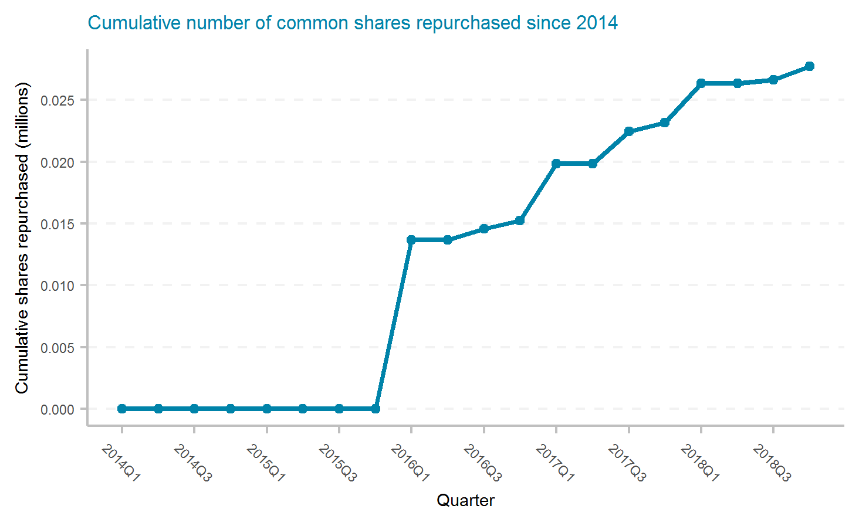
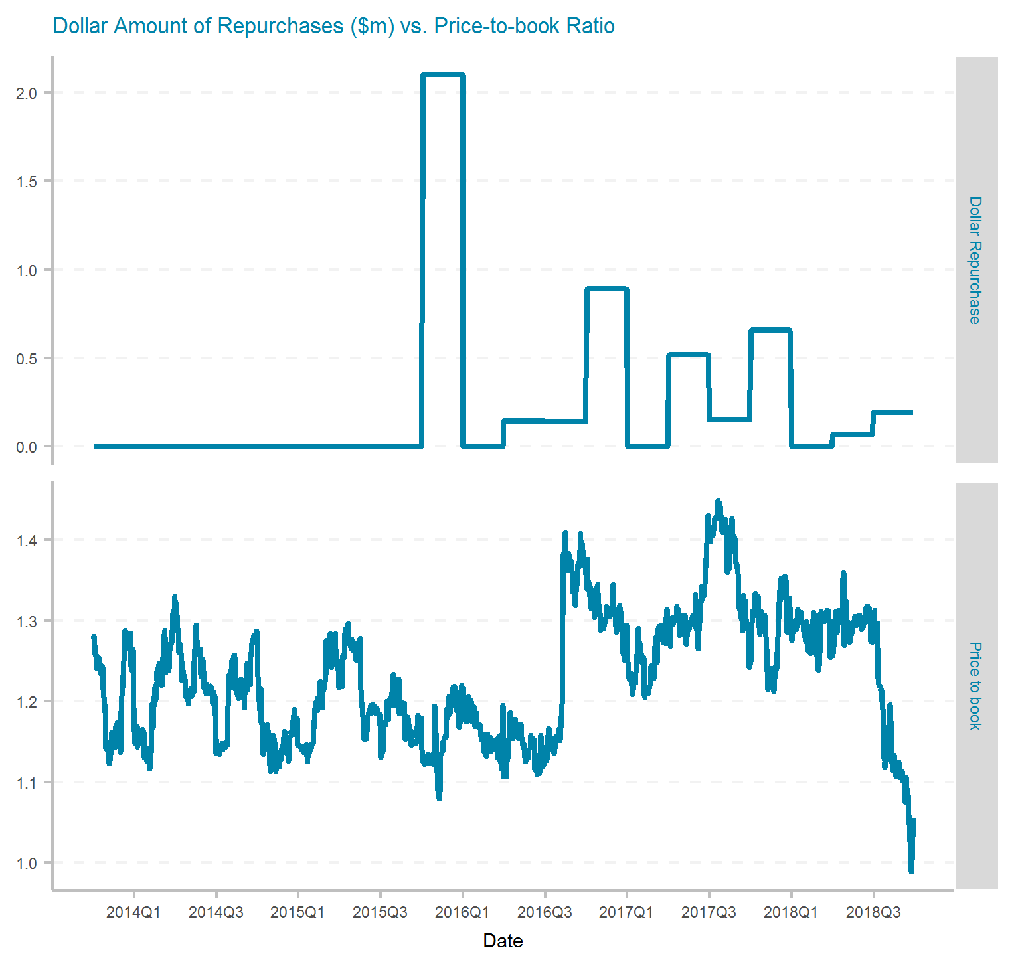
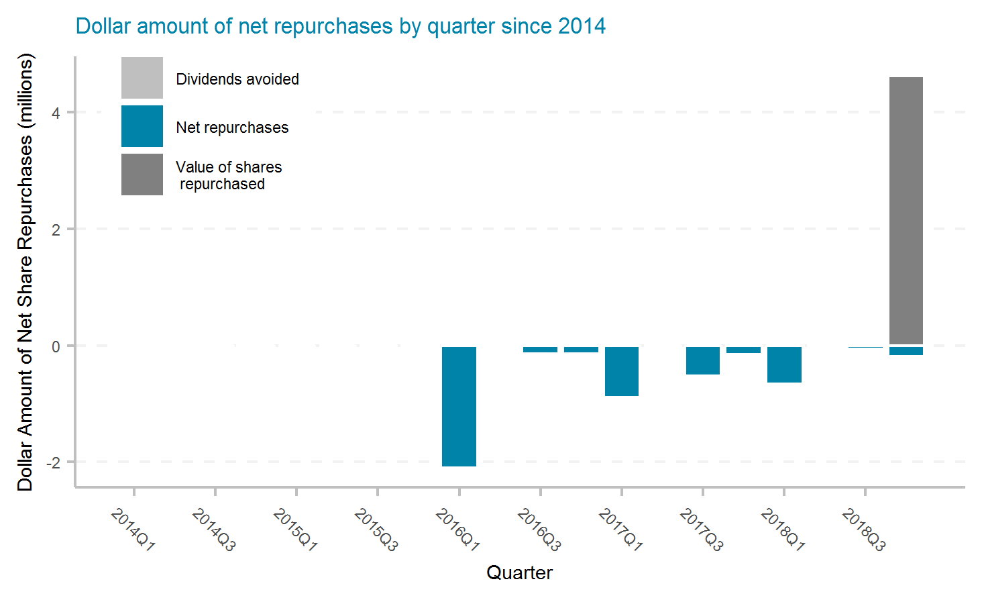
Enstar Group Limited
Ticker | # of quarters | Current Mkt Cap ($m) | Initial Shares (mil) | Shares Repurchased (mil) | Dollar Repurchased ($m) | Percent of Initial Shares Repurchased | Percent of Mkt Cap Repurchased | Total Shareholder Return | Buyback ROI | Buyback Effectiveness

Slide 24
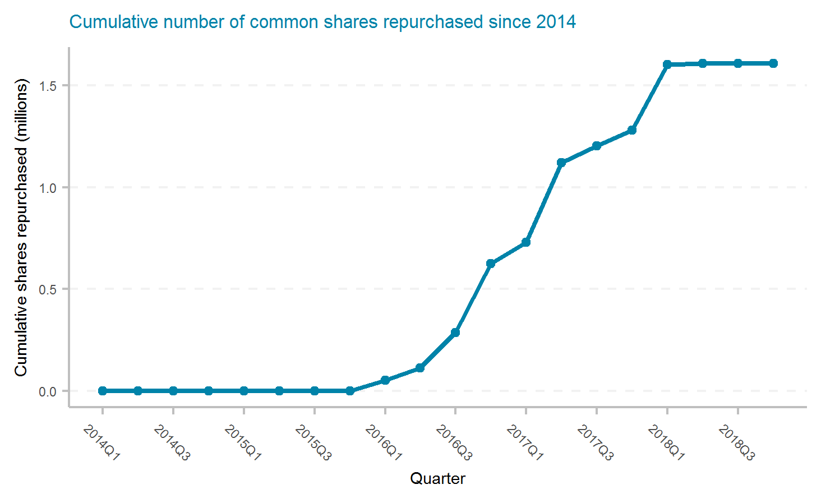
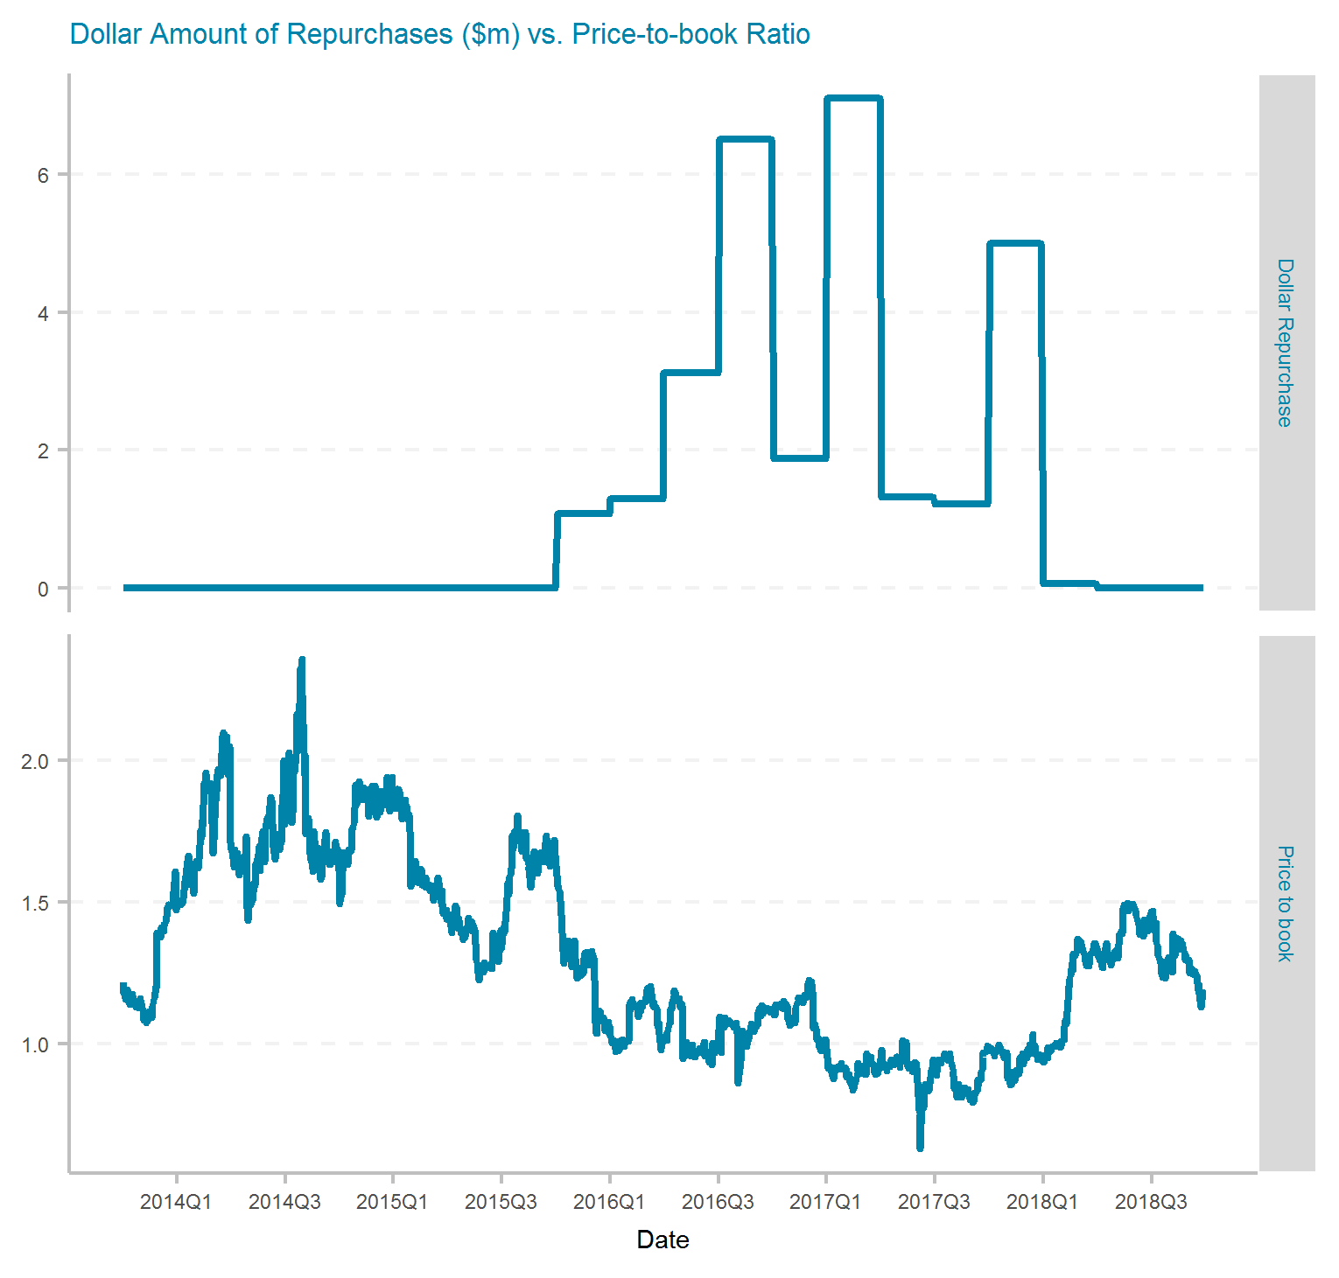
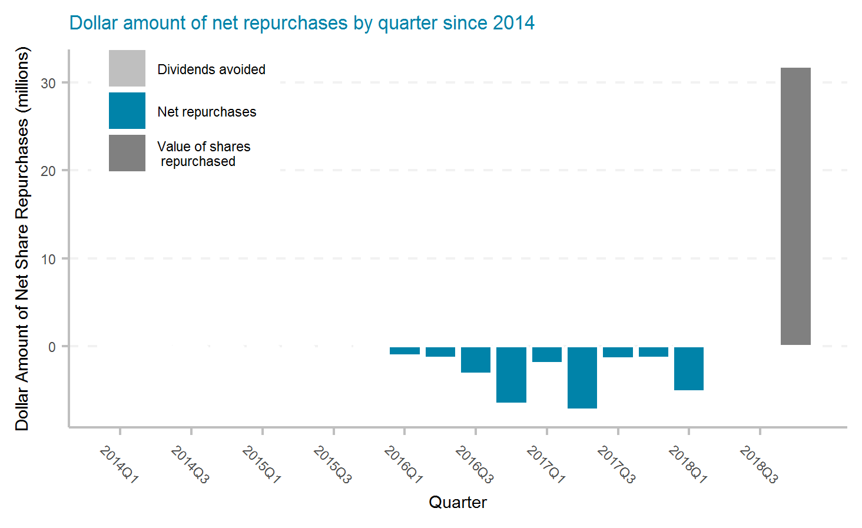
Federated National Holding Company
Ticker | # of quarters | Current Mkt Cap ($m) | Initial Shares (mil) | Shares Repurchased (mil) | Dollar Repurchased ($m) | Percent of Initial Shares Repurchased | Percent of Mkt Cap Repurchased | Total Shareholder Return | Buyback ROI | Buyback Effectiveness
FNHC | 20 | 205 | 11.0 | 1.6 | 29 | 14.6% | 13.9% | 2.7% | 8.4% | 5.5%

Slide 25
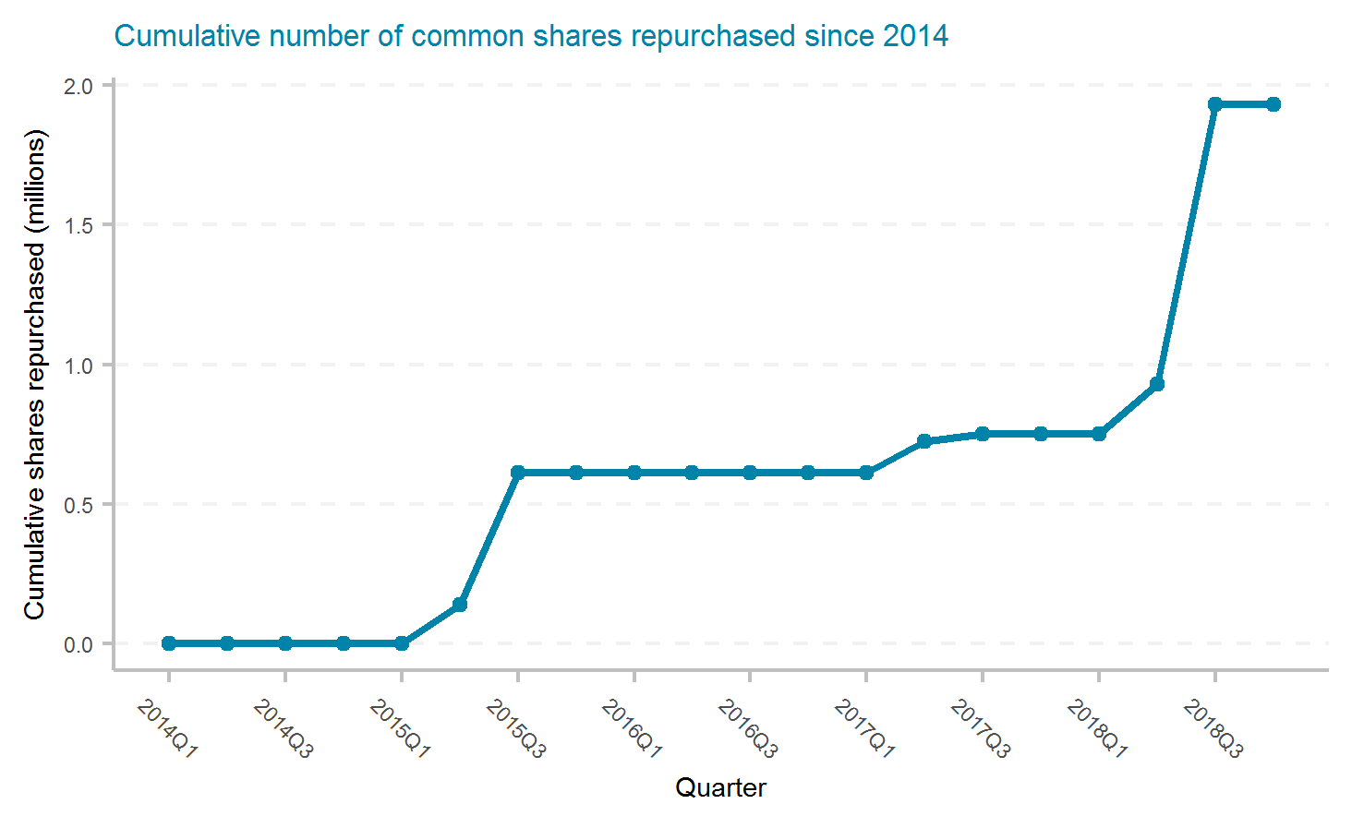
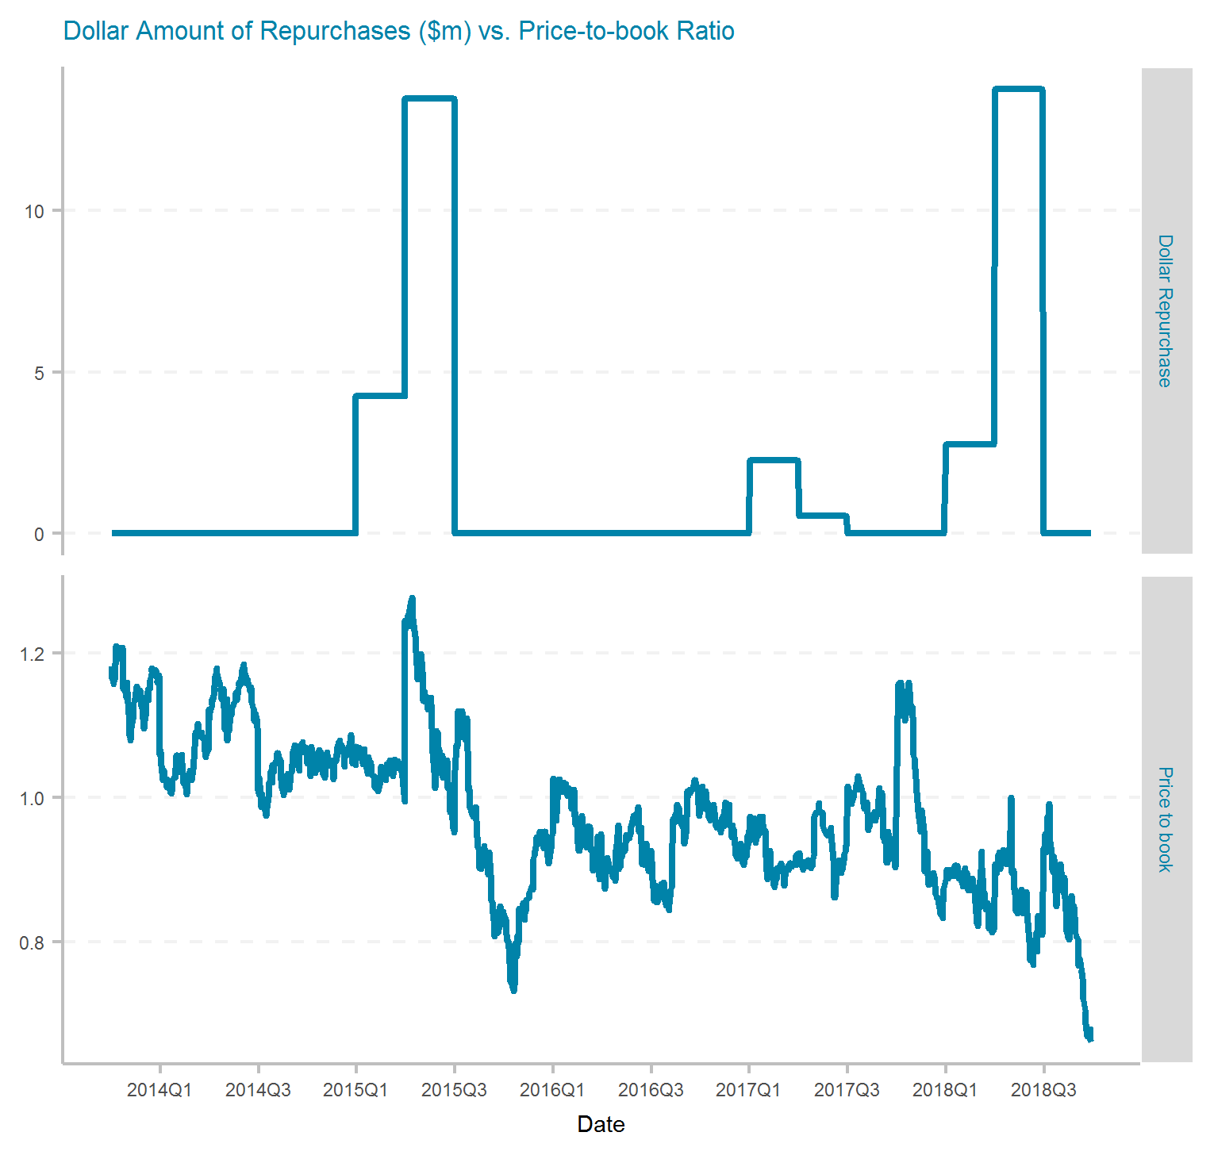
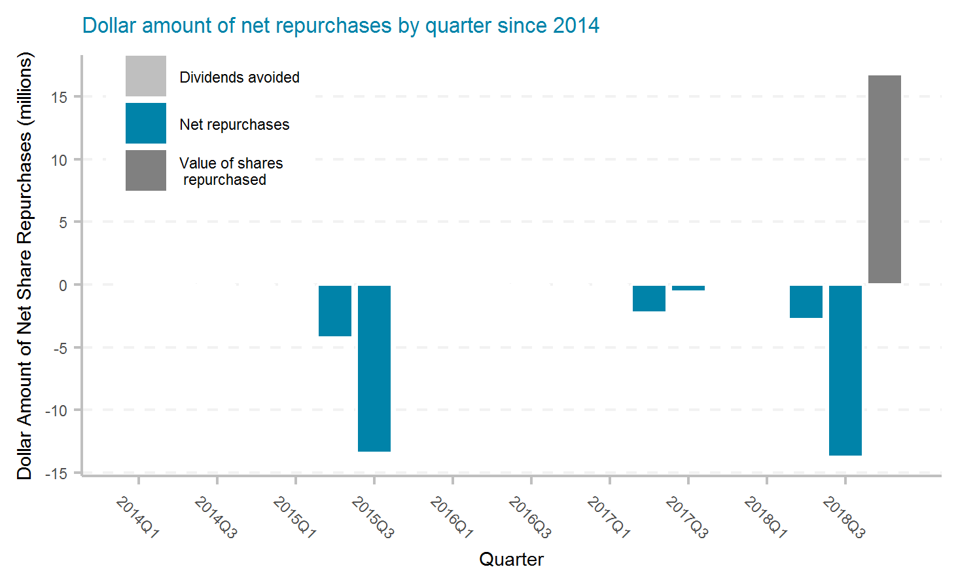
Greenlight Capital Re, Ltd.
Ticker | # of quarters | Current Mkt Cap ($m) | Initial Shares (mil) | Shares Repurchased (mil) | Dollar Repurchased ($m) | Percent of Initial Shares Repurchased | Percent of Mkt Cap Repurchased | Total Shareholder Return | Buyback ROI | Buyback Effectiveness
GLRE | 20 | 397 | 37.2 | 1.9 | 37 | 5.2% | 9.3% | -23.3% | -48.2% | -32.4%

Slide 26



Hallmark Financial Services, Inc.
Ticker | # of quarters | Current Mkt Cap ($m) | Initial Shares (mil) | Shares Repurchased (mil) | Dollar Repurchased ($m) | Percent of Initial Shares Repurchased | Percent of Mkt Cap Repurchased | Total Shareholder Return | Buyback ROI | Buyback Effectiveness
HALL | 20 | 185 | 19.3 | 1.6 | 18 | 8.5% | 9.5% | 5.1% | -0.3% | -5.2%

Slide 27



HCI Group, Inc.
Ticker | # of quarters | Current Mkt Cap ($m) | Initial Shares (mil) | Shares Repurchased (mil) | Dollar Repurchased ($m) | Percent of Initial Shares Repurchased | Percent of Mkt Cap Repurchased | Total Shareholder Return | Buyback ROI | Buyback Effectiveness
HCI | 20 | 367 | 11.0 | 3.1 | 120 | 28.5% | 32.6% | 9.8% | 15.2% | 4.9%

Slide 28



Hartford Financial Services Group, Inc.
Ticker | # of quarters | Current Mkt Cap ($m) | Initial Shares (mil) | Shares Repurchased (mil) | Dollar Repurchased ($m) | Percent of Initial Shares Repurchased | Percent of Mkt Cap Repurchased | Total Shareholder Return | Buyback ROI | Buyback Effectiveness
HIG | 20 | 17,400 | 452.5 | 129.4 | 5,392 | 28.6% | 31.0% | 6.6% | 4.1% | -2.3%

Slide 29



Horace Mann Educators Corporation
Ticker | # of quarters | Current Mkt Cap ($m) | Initial Shares (mil) | Shares Repurchased (mil) | Dollar Repurchased ($m) | Percent of Initial Shares Repurchased | Percent of Mkt Cap Repurchased | Total Shareholder Return | Buyback ROI | Buyback Effectiveness
HMN | 20 | 1,440 | 40.6 | 1.7 | 56 | 4.3% | 3.9% | 7.9% | 9.2% | 1.2%

Slide 30



Heritage Insurance Holdings, Inc.
Ticker | # of quarters | Current Mkt Cap ($m) | Initial Shares (mil) | Shares Repurchased (mil) | Dollar Repurchased ($m) | Percent of Initial Shares Repurchased | Percent of Mkt Cap Repurchased | Total Shareholder Return | Buyback ROI | Buyback Effectiveness
HRTG | 19 | 448 | 29.8 | 7.2 | 90 | 24.2% | 20.1% | 0.3% | 12.7% | 12.4%

Slide 31



James River Group Holdings, Ltd.
Ticker | # of quarters | Current Mkt Cap ($m) | Initial Shares (mil) | Shares Repurchased (mil) | Dollar Repurchased ($m) | Percent of Initial Shares Repurchased | Percent of Mkt Cap Repurchased | Total Shareholder Return | Buyback ROI | Buyback Effectiveness

Slide 32



Kingsway Financial Services Inc.
Ticker | # of quarters | Current Mkt Cap ($m) | Initial Shares (mil) | Shares Repurchased (mil) | Dollar Repurchased ($m) | Percent of Initial Shares Repurchased | Percent of Mkt Cap Repurchased | Total Shareholder Return | Buyback ROI | Buyback Effectiveness

Slide 33



Kingstone Companies, Inc.
Ticker | # of quarters | Current Mkt Cap ($m) | Initial Shares (mil) | Shares Repurchased (mil) | Dollar Repurchased ($m) | Percent of Initial Shares Repurchased | Percent of Mkt Cap Repurchased | Total Shareholder Return | Buyback ROI | Buyback Effectiveness
KINS | 20 | 163 | 7.3 | 0.2 | 2 | 2.4% | 1.2% | 22.6% | 29.0% | 5.2%

Slide 34



Kemper Corporation
Ticker | # of quarters | Current Mkt Cap ($m) | Initial Shares (mil) | Shares Repurchased (mil) | Dollar Repurchased ($m) | Percent of Initial Shares Repurchased | Percent of Mkt Cap Repurchased | Total Shareholder Return | Buyback ROI | Buyback Effectiveness
KMPR | 20 | 5,000 | 55.4 | 4.7 | 170 | 8.5% | 3.4% | 12.2% | 18.4% | 5.5%

Slide 35

Mercury General Corporation
Ticker | # of quarters | Current Mkt Cap ($m) | Initial Shares (mil) | Shares Repurchased (mil) | Dollar Repurchased ($m) | Percent of Initial Shares Repurchased | Percent of Mkt Cap Repurchased | Total Shareholder Return | Buyback ROI | Buyback Effectiveness

Slide 36



Maiden Holdings, Ltd.
Ticker | # of quarters | Current Mkt Cap ($m) | Initial Shares (mil) | Shares Repurchased (mil) | Dollar Repurchased ($m) | Percent of Initial Shares Repurchased | Percent of Mkt Cap Repurchased | Total Shareholder Return | Buyback ROI | Buyback Effectiveness
MHLD | 20 | 62 | 72.8 | 4.0 | 28 | 5.5% | 44.5% | -20.5% | -69.0% | -61.0%

Slide 37



Markel Corporation
Ticker | # of quarters | Current Mkt Cap ($m) | Initial Shares (mil) | Shares Repurchased (mil) | Dollar Repurchased ($m) | Percent of Initial Shares Repurchased | Percent of Mkt Cap Repurchased | Total Shareholder Return | Buyback ROI | Buyback Effectiveness
MKL | 20 | 13,680 | 14.0 | 0.2 | 185 | 1.6% | 1.4% | 11.2% | 9.5% | -1.6%

Slide 38

Navigators Group, Inc.
Ticker | # of quarters | Current Mkt Cap ($m) | Initial Shares (mil) | Shares Repurchased (mil) | Dollar Repurchased ($m) | Percent of Initial Shares Repurchased | Percent of Mkt Cap Repurchased | Total Shareholder Return | Buyback ROI | Buyback Effectiveness

Slide 39

National General Holdings Corporation
Ticker | # of quarters | Current Mkt Cap ($m) | Initial Shares (mil) | Shares Repurchased (mil) | Dollar Repurchased ($m) | Percent of Initial Shares Repurchased | Percent of Mkt Cap Repurchased | Total Shareholder Return | Buyback ROI | Buyback Effectiveness

Slide 40

Old Republic International Corporation
Ticker | # of quarters | Current Mkt Cap ($m) | Initial Shares (mil) | Shares Repurchased (mil) | Dollar Repurchased ($m) | Percent of Initial Shares Repurchased | Percent of Mkt Cap Repurchased | Total Shareholder Return | Buyback ROI | Buyback Effectiveness

Slide 41



Progressive Corporation
Ticker | # of quarters | Current Mkt Cap ($m) | Initial Shares (mil) | Shares Repurchased (mil) | Dollar Repurchased ($m) | Percent of Initial Shares Repurchased | Percent of Mkt Cap Repurchased | Total Shareholder Return | Buyback ROI | Buyback Effectiveness
PGR | 20 | 42,460 | 593.1 | 27.4 | 814 | 4.6% | 1.9% | 22.4% | 28.0% | 4.6%

Slide 42



1347 Property Insurance Holdings, Inc.
Ticker | # of quarters | Current Mkt Cap ($m) | Initial Shares (mil) | Shares Repurchased (mil) | Dollar Repurchased ($m) | Percent of Initial Shares Repurchased | Percent of Mkt Cap Repurchased | Total Shareholder Return | Buyback ROI | Buyback Effectiveness
PIH | 19 | 32 | 6.4 | 1.7 | 13 | 26.9% | 39.5% | -15.3% | -21.9% | -7.8%

Slide 43



ProAssurance Corporation
Ticker | # of quarters | Current Mkt Cap ($m) | Initial Shares (mil) | Shares Repurchased (mil) | Dollar Repurchased ($m) | Percent of Initial Shares Repurchased | Percent of Mkt Cap Repurchased | Total Shareholder Return | Buyback ROI | Buyback Effectiveness
PRA | 20 | 1,880 | 59.5 | 8.6 | 394 | 14.5% | 21.0% | 10.4% | 14.5% | 3.8%

Slide 44



Everest Re Group, Ltd.
Ticker | # of quarters | Current Mkt Cap ($m) | Initial Shares (mil) | Shares Repurchased (mil) | Dollar Repurchased ($m) | Percent of Initial Shares Repurchased | Percent of Mkt Cap Repurchased | Total Shareholder Return | Buyback ROI | Buyback Effectiveness
RE | 20 | 8,740 | 46.1 | 8.4 | 1,462 | 18.2% | 16.7% | 9.3% | 9.7% | 0.3%

Slide 45

RLI Corp.
Ticker | # of quarters | Current Mkt Cap ($m) | Initial Shares (mil) | Shares Repurchased (mil) | Dollar Repurchased ($m) | Percent of Initial Shares Repurchased | Percent of Mkt Cap Repurchased | Total Shareholder Return | Buyback ROI | Buyback Effectiveness

Slide 46



RenaissanceRe Holdings Ltd.
Ticker | # of quarters | Current Mkt Cap ($m) | Initial Shares (mil) | Shares Repurchased (mil) | Dollar Repurchased ($m) | Percent of Initial Shares Repurchased | Percent of Mkt Cap Repurchased | Total Shareholder Return | Buyback ROI | Buyback Effectiveness
RNR | 20 | 6,080 | 40.9 | 12.2 | 1,312 | 29.9% | 21.6% | 7.2% | 7.6% | 0.4%

Slide 47



Safety Insurance Group, Inc.
Ticker | # of quarters | Current Mkt Cap ($m) | Initial Shares (mil) | Shares Repurchased (mil) | Dollar Repurchased ($m) | Percent of Initial Shares Repurchased | Percent of Mkt Cap Repurchased | Total Shareholder Return | Buyback ROI | Buyback Effectiveness
SAFT | 20 | 1,330 | 15.5 | 0.5 | 23 | 3.0% | 1.8% | 12.3% | 16.5% | 3.8%

Slide 48



Selective Insurance Group, Inc.
Ticker | # of quarters | Current Mkt Cap ($m) | Initial Shares (mil) | Shares Repurchased (mil) | Dollar Repurchased ($m) | Percent of Initial Shares Repurchased | Percent of Mkt Cap Repurchased | Total Shareholder Return | Buyback ROI | Buyback Effectiveness
SIGI | 20 | 3,730 | 56.2 | 0.7 | 25 | 1.2% | 0.7% | 22.0% | 24.0% | 1.7%

Slide 49

State Auto Financial Corporation
Ticker | # of quarters | Current Mkt Cap ($m) | Initial Shares (mil) | Shares Repurchased (mil) | Dollar Repurchased ($m) | Percent of Initial Shares Repurchased | Percent of Mkt Cap Repurchased | Total Shareholder Return | Buyback ROI | Buyback Effectiveness

Slide 50



Hanover Insurance Group, Inc.
Ticker | # of quarters | Current Mkt Cap ($m) | Initial Shares (mil) | Shares Repurchased (mil) | Dollar Repurchased ($m) | Percent of Initial Shares Repurchased | Percent of Mkt Cap Repurchased | Total Shareholder Return | Buyback ROI | Buyback Effectiveness
THG | 20 | 4,620 | 43.8 | 4.9 | 401 | 11.1% | 8.7% | 15.4% | 17.2% | 1.5%

Slide 51



Third Point Reinsurance Ltd.
Ticker | # of quarters | Current Mkt Cap ($m) | Initial Shares (mil) | Shares Repurchased (mil) | Dollar Repurchased ($m) | Percent of Initial Shares Repurchased | Percent of Mkt Cap Repurchased | Total Shareholder Return | Buyback ROI | Buyback Effectiveness
TPRE | 20 | 979 | 103.9 | 14.3 | 187 | 13.7% | 19.1% | -9.7% | -38.7% | -32.2%

Slide 52



Travelers Companies, Inc.
Ticker | # of quarters | Current Mkt Cap ($m) | Initial Shares (mil) | Shares Repurchased (mil) | Dollar Repurchased ($m) | Percent of Initial Shares Repurchased | Percent of Mkt Cap Repurchased | Total Shareholder Return | Buyback ROI | Buyback Effectiveness
TRV | 20 | 35,540 | 347.5 | 109.4 | 11,790 | 31.5% | 33.2% | 9.3% | 6.1% | -2.9%

Slide 53



United Fire Group, Inc.
Ticker | # of quarters | Current Mkt Cap ($m) | Initial Shares (mil) | Shares Repurchased (mil) | Dollar Repurchased ($m) | Percent of Initial Shares Repurchased | Percent of Mkt Cap Repurchased | Total Shareholder Return | Buyback ROI | Buyback Effectiveness
UFCS | 20 | 1,100 | 25.4 | 1.5 | 54 | 5.7% | 4.9% | 16.8% | 26.0% | 7.9%

Slide 54

United Insurance Holdings Corp.
Ticker | # of quarters | Current Mkt Cap ($m) | Initial Shares (mil) | Shares Repurchased (mil) | Dollar Repurchased ($m) | Percent of Initial Shares Repurchased | Percent of Mkt Cap Repurchased | Total Shareholder Return | Buyback ROI | Buyback Effectiveness

Slide 55



Universal Insurance Holdings, Inc.
Ticker | # of quarters | Current Mkt Cap ($m) | Initial Shares (mil) | Shares Repurchased (mil) | Dollar Repurchased ($m) | Percent of Initial Shares Repurchased | Percent of Mkt Cap Repurchased | Total Shareholder Return | Buyback ROI | Buyback Effectiveness
UVE | 20 | 1,070 | 34.8 | 5.0 | 100 | 14.5% | 9.4% | 27.1% | 31.1% | 3.2%

Slide 56



W. R. Berkley Corporation
Ticker | # of quarters | Current Mkt Cap ($m) | Initial Shares (mil) | Shares Repurchased (mil) | Dollar Repurchased ($m) | Percent of Initial Shares Repurchased | Percent of Mkt Cap Repurchased | Total Shareholder Return | Buyback ROI | Buyback Effectiveness
WRB | 20 | 10,240 | 127.6 | 13.8 | 668 | 10.8% | 6.5% | 15.2% | 17.4% | 1.8%

Slide 57



White Mountains Insurance Group, Ltd.
Ticker | # of quarters | Current Mkt Cap ($m) | Initial Shares (mil) | Shares Repurchased (mil) | Dollar Repurchased ($m) | Percent of Initial Shares Repurchased | Percent of Mkt Cap Repurchased | Total Shareholder Return | Buyback ROI | Buyback Effectiveness
WTM | 20 | 2,910 | 6.2 | 3.1 | 2,549 | 50.8% | 87.6% | 7.5% | 2.8% | -4.4%

Slide 58



Alleghany Corporation
Ticker | # of quarters | Current Mkt Cap ($m) | Initial Shares (mil) | Shares Repurchased (mil) | Dollar Repurchased ($m) | Percent of Initial Shares Repurchased | Percent of Mkt Cap Repurchased | Total Shareholder Return | Buyback ROI | Buyback Effectiveness
Y | 20 | 8,760 | 16.5 | 2.2 | 1,120 | 13.6% | 12.8% | 9.3% | 10.5% | 1.0%

